Slide 1
Eli’s Wicked Sons
1 Samuel 2:12-29, 34-35; 3:1-4:1a

Slide 2
Those who honor me I will honor, but those who despise me will be disdained. I Samuel 2:30d DigSite #2
Memory Work

Slide 3
Eli’s sons were scoundrels;
they had no regard for the Lord.

Slide 4

Now it was the practice of the priests that, whenever any of the people offered a sacrifice, the priest’s servant would come with a three-pronged fork in his hand while the meat was being boiled and would plunge the fork into the pan or kettle or caldron or pot.

Slide 5
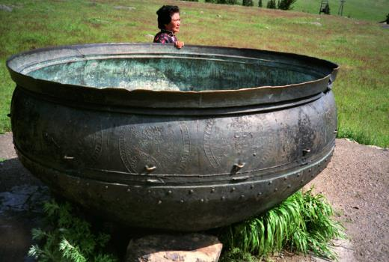

Whatever the fork brought up the priest
would take for himself.
This is how they treated all the Israelites
who came to Shiloh.

Slide 6
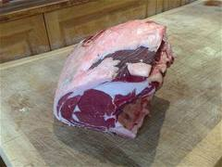
But even before the fat was burned, the priest’s servant would come and say to the person who was sacrificing,
“Give the priest some meat to roast; he won’t accept boiled meat from you, but only raw.”

Slide 7
If the person said to him, “Let the fat be burned first, and then take whatever you want,” the servant would answer,
“No, hand it over now;

Slide 8
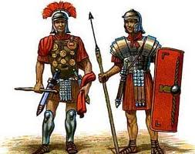
if you don’t, I’ll take it by FORCE.”

Slide 9
This sin of the young men was very great in the Lord’s sight, for they were treating the Lord’s offering with contempt.

Slide 10

But Samuel was ministering before the
Lord—a boy wearing a linen ephod.

Slide 11
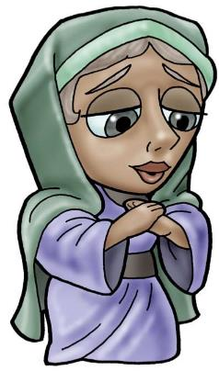
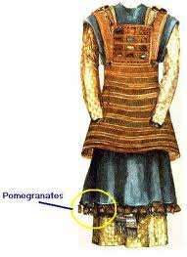
Each year his mother made him a little robe
and took it to him when she went up with her
husband to offer the annual sacrifice.

Slide 12
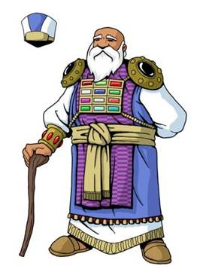
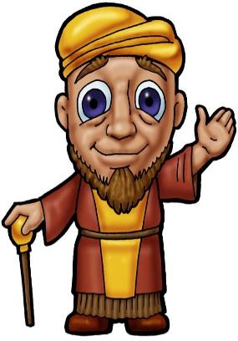
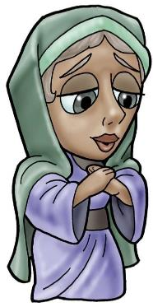

Eli would bless Elkanah and his wife, saying,
“May the Lord give you children by this woman to take the place of the one she prayed for and gave to the Lord.” Then they would go home.

Slide 13


And the Lord was gracious to Hannah; she gave birth
to three sons and two daughters.

Slide 14
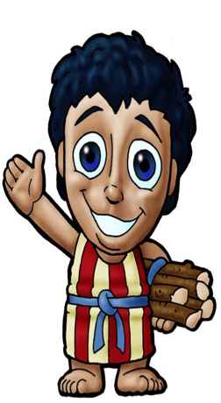
Meanwhile, the boy,
Samuel grew up in the presence of the Lord.

Slide 15
Now Eli, who was very old,
heard about everything his sons were doing to all Israel and how they slept with the women who served at the entrance to the tent of meeting.
Israel

Slide 16
So he said to them,
“Why do you do such things?
I hear from all the people about these wicked deed of yours.
No, my sons; the report I hear spreading among the Lord’s people is not good.

Slide 17
If one person sins against another, God may mediate for the offender; but if anyone sins against the Lord, who will intercede for them?”
WHO
?

Slide 18


His sons, however, did not listen to their father’s rebuke,
X

Slide 19

for it was the Lord’s will to put them to death.

Slide 20

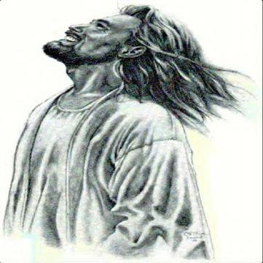
And the boy Samuel continued to grow in stature and in favor with the Lord and with people.

Slide 21
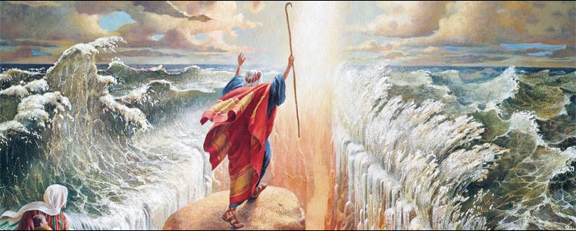
Now a man of God came to Eli and said to him,
“This is what the Lord says: ‘Did I not clearly reveal myself to your ancestor’s family when they were in Egypt under Pharaoh?

Slide 22
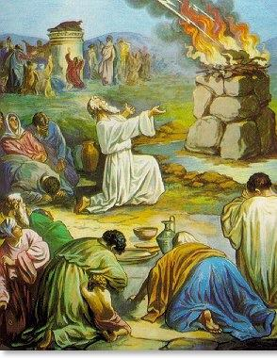
I chose your ancestor out of all the tribes of Israel to be my priest, to go up to my altar, to burn incense, and to wear an ephod in my presence. I also gave your ancestor’s family all the food offerings presented by the Israelites

Slide 23
Why do you scorn my sacrifice and offering that I prescribed for my dwelling?

Slide 24
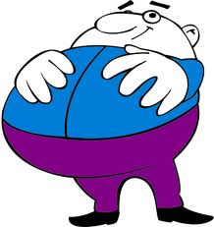
Why do you honor your sons more than me by fattening yourselves on the choice parts of every offering made by my people Israel?’

Slide 25
And what happens to your two sons,
Hophni and Phinehas, will be a sign to you

Slide 26


they will both die on the same day.

Slide 27


I will raise up for myself a faithful priest,
who will do according to what is in my heart and mind. I will firmly establish his priestly house, and they will minister before my anointed one always.

Slide 28

The boy Samuel ministered before the Lord under Eli. In those days the word of the Lord was rare; there were not many visions.

Slide 29
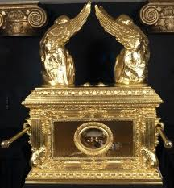
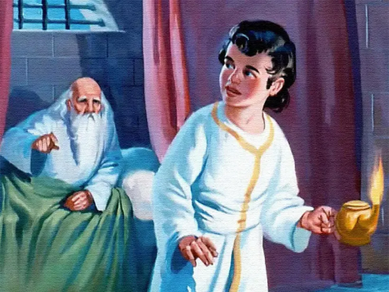

One night Eli, whose eyes were becoming so weak that he could barely see, was lying down in his usual place. The lamp of God had not yet gone out, and Samuel was lying down in the house of the Lord, where the ark of God was.

Slide 30
Then the Lord called Samuel.
Samuel answered, “Here I am.”

Slide 31

And he ran to Eli and said,
“Here I am; you called me.”
But Eli said, “I did not call; go back and lie down.”

Slide 32
So he went and lay down.
Again the Lord called, “Samuel!”

Slide 33

And Samuel got up and went to Eli and said,
“Here I am; you called me.”
“My son,” Eli said,
“I did not call; go back and lie down.”
2X

Slide 34
Now Samuel did not yet know the Lord:
The word of the Lord had not yet
been revealed to him.
A third time the Lord called, “Samuel!”
And Samuel got up and went to Eli and said, “Here I am; you called me.”
3X

Slide 35
Then Eli realized that the Lord was calling the boy. So Eli told Samuel, “Go and lie down, and if he calls you, say, ‘Speak, Lord, for your servant is listening.’”
So Samuel went and lay down in his place.
3X

Slide 36

The Lord came and stood there, calling as at the other times, “Samuel! Samuel!”

Slide 37

Then Samuel said,
“Speak, for your servant is listening.”

Slide 38

And the Lord said to Samuel: “See, I am about to do something in Israel that will make the ears of everyone who hears about it tingle.
At that time I will carry out against Eli everything I spoke against his family—from beginning to end.

Slide 39
For I told him that I would judge his family forever because of the sin he knew about;
his sons blasphemed God, and he failed to restrain them.
Therefore I swore to the house of Eli,
‘The guilt of Eli’s house will never be atoned for by sacrifice or offering.’”

Slide 40
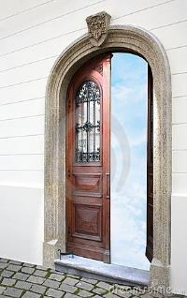

Samuel lay down until morning and then opened the doors of the house of the Lord. He was afraid to tell Eli the vision,
but Eli called him and said, “Samuel, my son.”
Samuel answered, “Here I am.”

Slide 41

“What was it he said to you?” Eli asked. “Do not hide it from me. May God deal with you, be it ever so severely, if you hide from me anything he told you.”

Slide 42
So Samuel told him everything,
hiding nothing from him.
Then Eli said, “He is the Lord;
let him do what is good in his eyes.”

Slide 43

The Lord was with Samuel as he grew up,
and he let none of Samuel’s words fall to the ground.
WORD

Slide 44
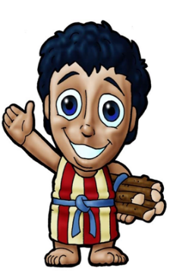
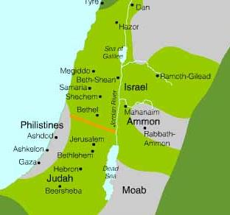
And all Israel from Dan to Beersheba recognized that Samuel was attested as a prophet of the Lord.

Slide 45
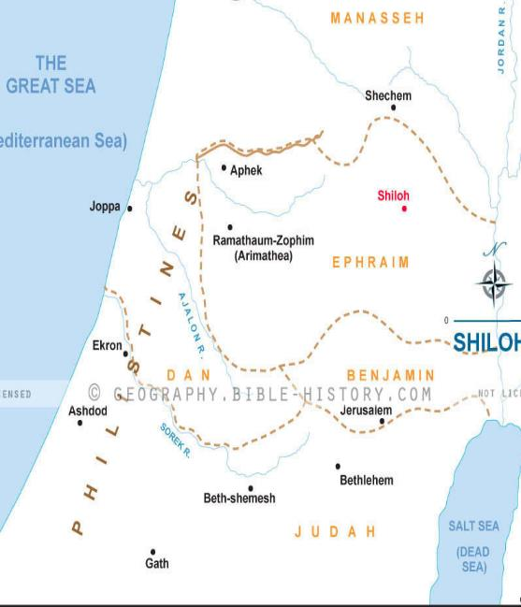
The Lord continued to appear at Shiloh, and there he revealed himself to Samuel through his word.

Slide 46
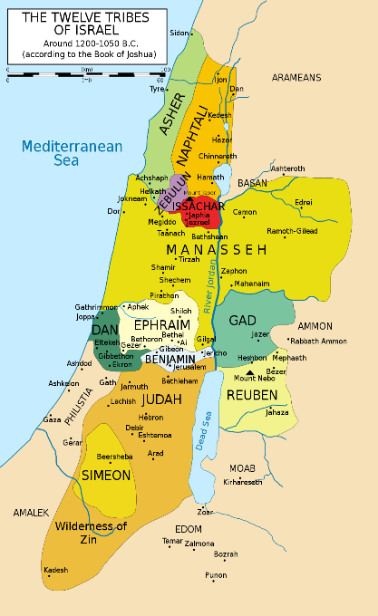
And Samuel’s word
came to all Israel.

