Slide 1

Dig Site 9: Love Tested
Genesis 21:1-6; 22:1-18

Slide 2
The Truth
God helps us obey Him in all situations!

Slide 3
Memory Verse
Because you have done this and have not withheld your son, your only son, I will surely bless you.
Genesis 22:16b-17a

Slide 4
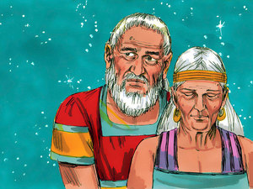
Now the Lord was gracious to Sarah as he had said, and the Lord did for Sarah what he had promised.

Slide 5
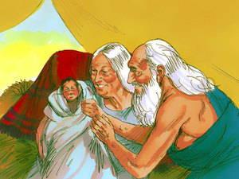
Sarah became pregnant and bore a son to Abraham in his old age, at the very time God had promised him.

Slide 6
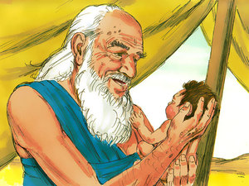
Abraham gave the name Isaac to the son Sarah bore him.
I will call you Isaac which means “laughter”!

Slide 7
When his son Isaac was eight days old, Abraham circumcised him, as God commanded him.

Slide 8
Abraham was 100 years old when his son Isaac was born to him.

Slide 9
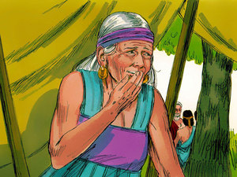
Sarah said,
God has brought me laughter, and everyone who hears about this will laugh with me.

Slide 10
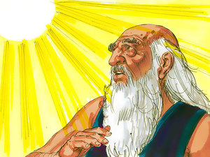
Some time later God tested Abraham.
He said to him, “Abraham!”
“Here I am,” he replied.

Slide 11
Then God said,
Take your son, your only son, whom you love—Isaac—and go to the region of Moriah.

Slide 12
Sacrifice him there as a burnt offering on a mountain I will show you.

Slide 13
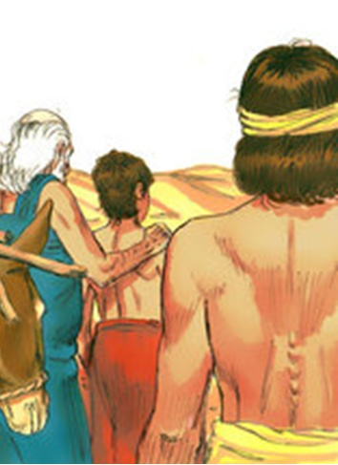
Early the next morning Abraham got up and loaded his donkey. He took with him two of his servants and his son Isaac.

Slide 14
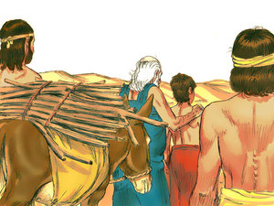
When he had cut enough wood for the burnt offering, he set out for the place God had told him about.

Slide 15
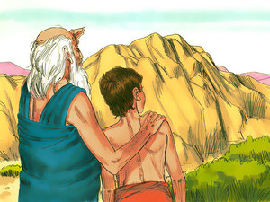
On the third day Abraham looked up and saw the place in the distance.

Slide 16
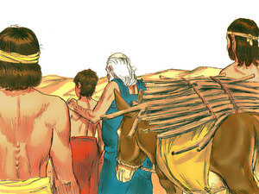
He said to his servants,
Stay here with the donkey while
I and the boy go over there.
We will worship and
then we will come back to you.

Slide 17

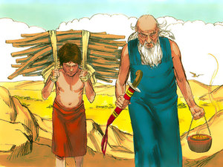
Abraham took the wood for the burnt offering and placed it on his son Isaac, and he himself carried the fire and the knife.

Slide 18
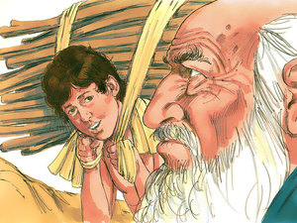
As the two of them went on together, Isaac spoke up and said to his father Abraham,
Father?
Yes, my son?
Abraham replied.

Slide 19
The fire and wood are here,

Slide 20
but where is the lamb for the burnt offering?

Slide 21
God himself will provide the lamb for the burnt offering, my son.

Slide 22
And the two of them went on together.

Slide 23
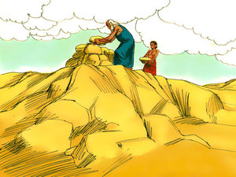
When they reached the place God had told him about, Abraham built an altar there and arranged the wood on it.

Slide 24
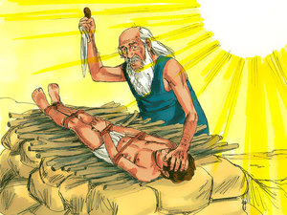
He bound his son Isaac and laid him on the altar, on top of the wood.

Slide 25
Then he reached out his hand and took the knife to slay his son.

Slide 26
But the angel of the Lord called out to him from heaven,

Slide 27
Abraham! Abraham!

Slide 28
Here I am!

Slide 29
Do not lay a hand on the boy,

Slide 30
Do not do anything to him.

Slide 31
Now I know that you fear God, because you have not withheld from me your son,
your only son.

Slide 32
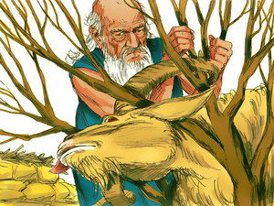
Abraham looked up and there in a thicket he saw a ram caught by its horns.

Slide 33
He went over and took the ram and sacrificed it as a burnt offering instead of his son.

Slide 34
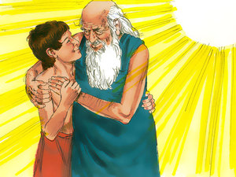
So Abraham called that place The Lord Will Provide.

Slide 35
And to this day it is said, “On the mountain of the Lord it will be provided.”

Slide 36
The angel of the Lord called to Abraham from heaven a second time and said,

Slide 37
I swear by myself, declares the Lord, that because you have done this and have not withheld your son, your only son,

Slide 38
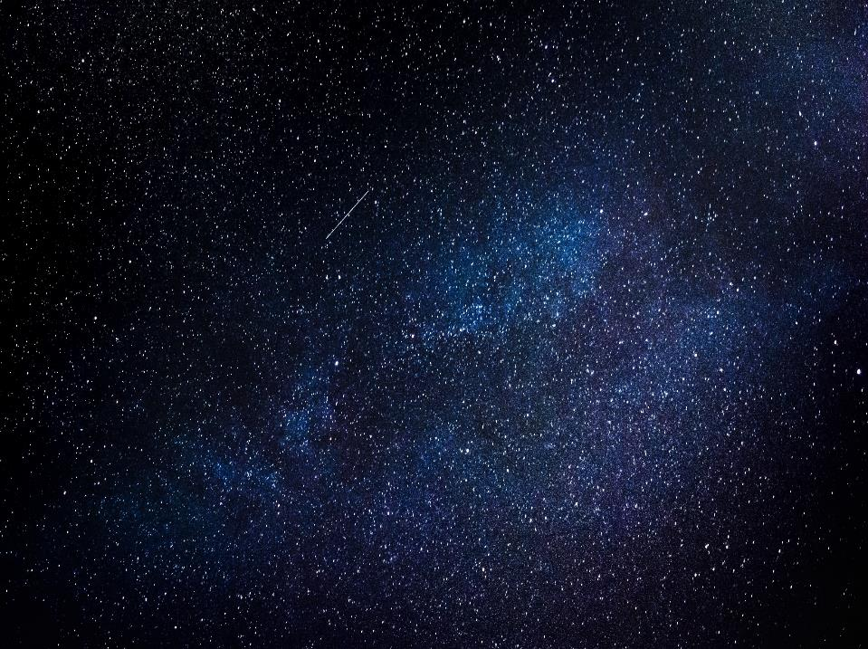
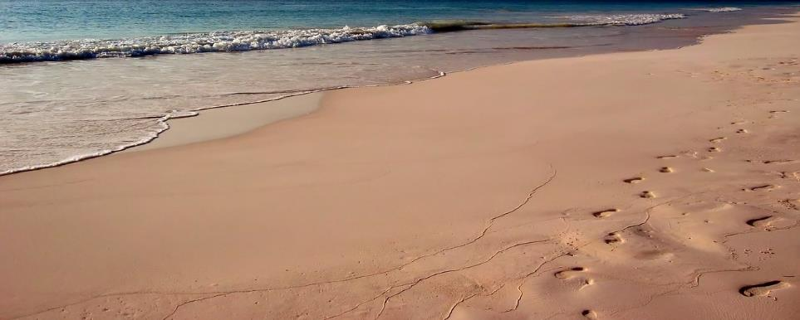
I will surely bless you and make your descendants as numerous as the stars in the sky and as the sand on the seashore.

Slide 39
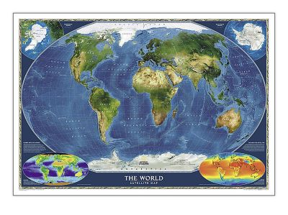
Your descendants will take possession of the cities of their enemies, and through your offspring all nations on earth will be blessed, because you have obeyed me.

