Slide 1
Dig Site 6
Genesis 9:1-20, 28-29
The Rainbow in the Clouds

Slide 2
The Truth
God established a covenant with people!
Covenant: an agreement between God and His people; a binding contract

Slide 3
Memory Verse
I have set my rainbow in the clouds, and it will be the sign of the covenant between me and the earth.
Genesis 9:13

Slide 4
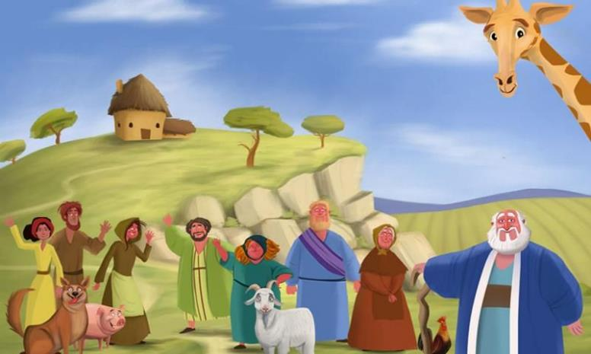
God’s Covenant With Noah
Then God blessed Noah and his sons, saying to them, “Be fruitful and increase in number and fill the earth.

Slide 5
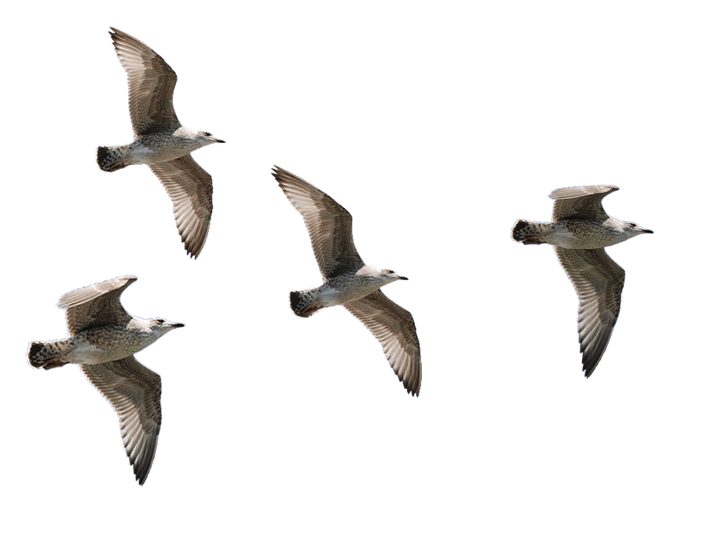
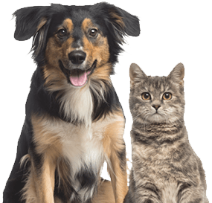
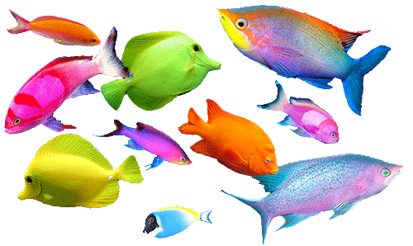
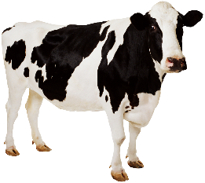
The fear and dread of you will fall on all the beasts of the earth, and on all the birds in the sky, on every creature that moves along the ground, and on all the fish in the sea; they are given into your hands.

Slide 6
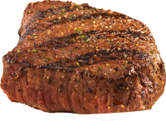
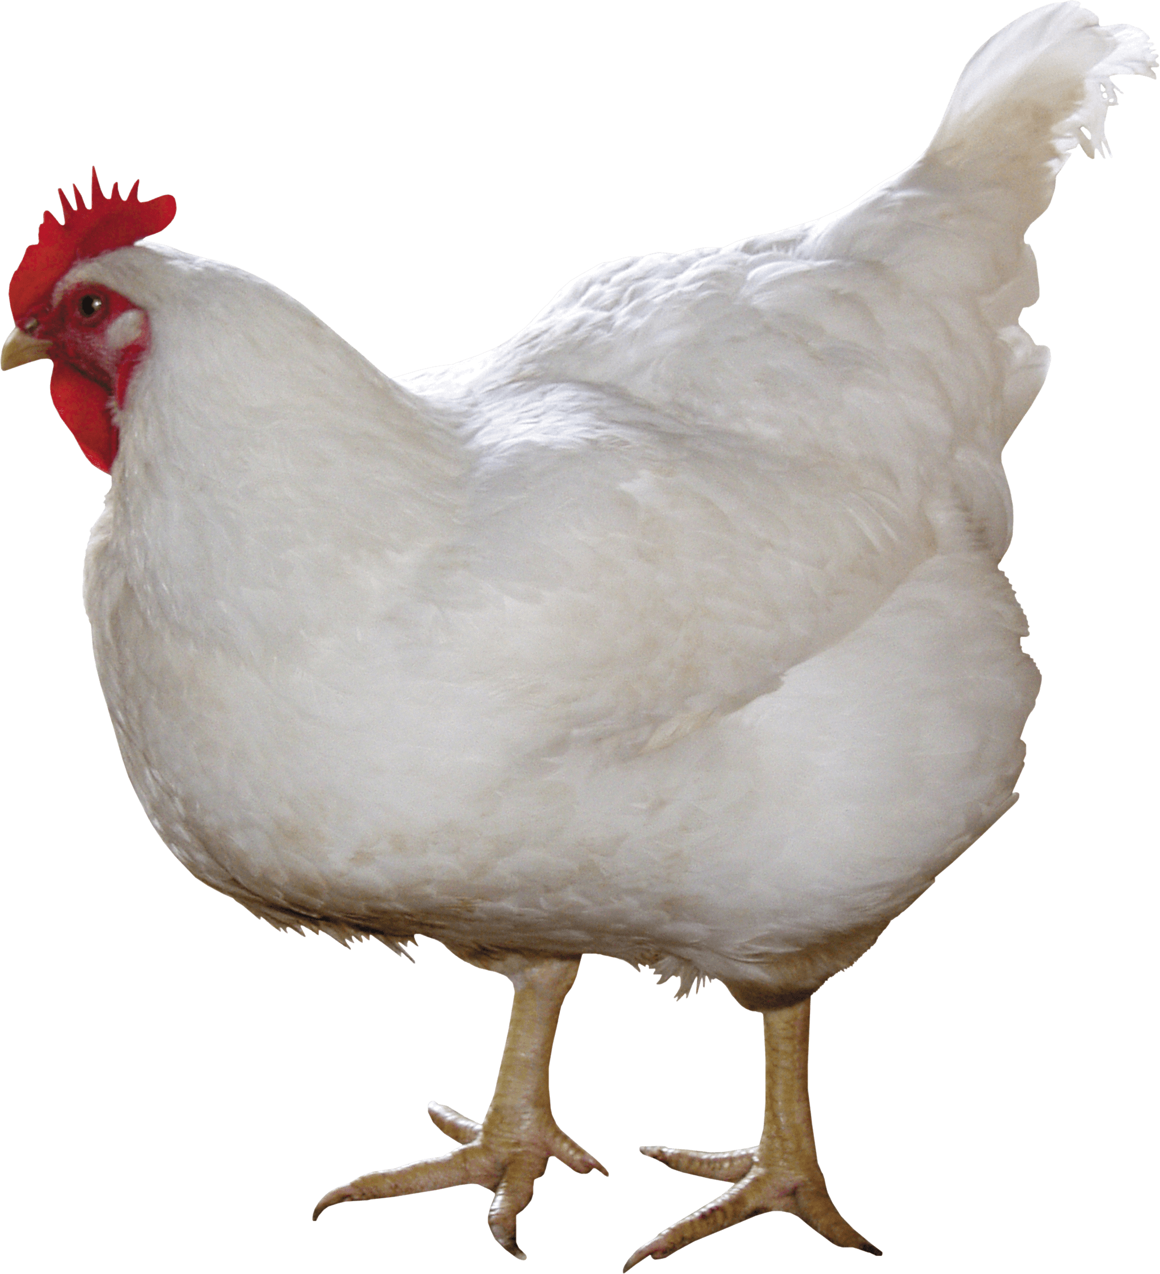
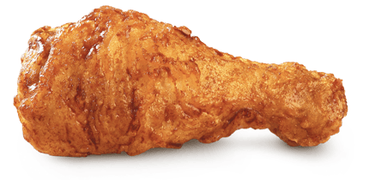
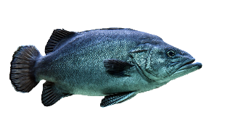
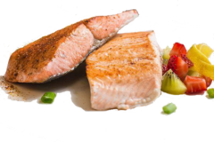
Everything that lives and moves about will be food for you. Just as I gave you the green plants, I now give you everything.

Slide 7
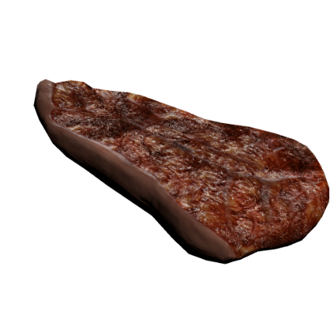

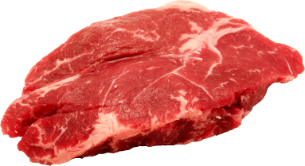
“But you must not eat meat that has its lifeblood still in it. And for your lifeblood I will surely demand an accounting. I will demand an accounting from every animal. And from each human being, too, I will demand an accounting for the life of another human being.
Yum!

Slide 8


“Whoever sheds human blood, by humans shall their blood be shed; for in the image of God has God made mankind.

Slide 9

As for you, be fruitful and increase in number; multiply on the earth and increase upon it.”

Slide 10
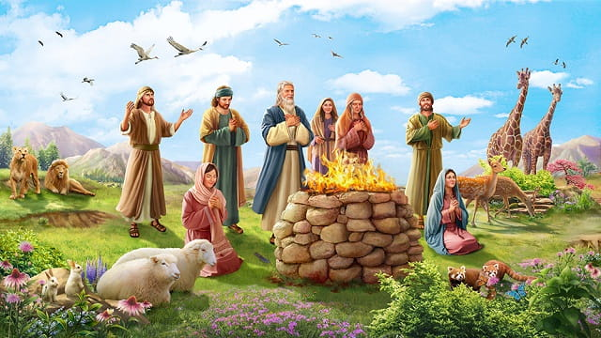
Then God said to Noah and to his sons with him: “I now establish my covenant with you and with your descendants after you and with every living creature that was with you—the birds, the livestock and all the wild animals, all those that came out of the ark with you—every living creature on earth.

Slide 11
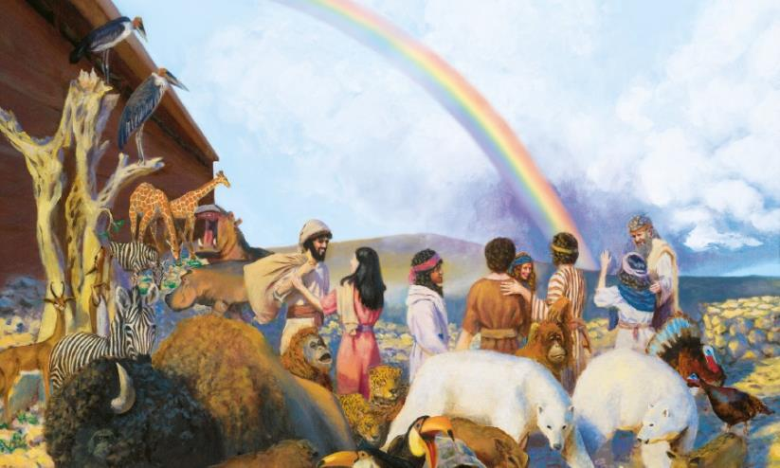
I establish my covenant with you: Never again will all life be destroyed by the waters of a flood; never again will there be a flood to destroy the earth.”

Slide 12
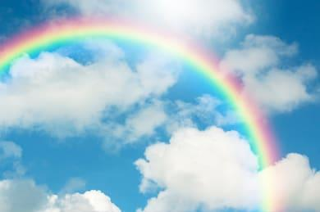
I have set my rainbow in the clouds, and it will be the sign of the covenant between me and the earth.
(Memory Verse: Genesis 9:13)
And God said, “This is the sign of the covenant I am making between me and you and every living creature with you, a covenant for all generations to come:

Slide 13
Whenever I bring clouds over the earth and the rainbow appears in the clouds, I will remember my covenant between me and you and all living creatures of every kind.

Slide 14

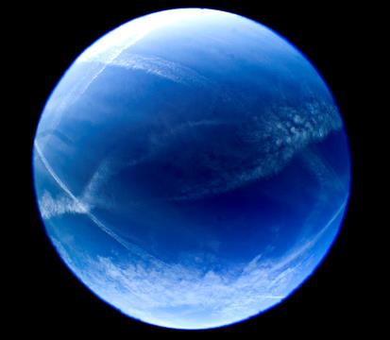
Never again will the waters become a flood to destroy all life.

Slide 15
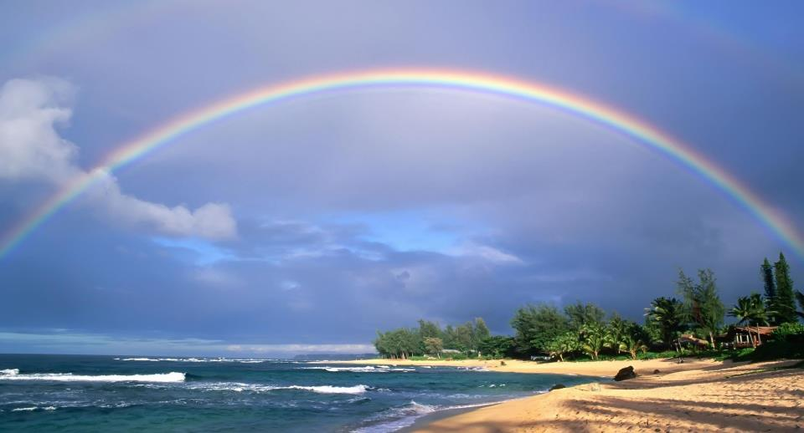
Whenever the rainbow appears in the clouds, I will see it and remember the everlasting covenant between God and all living creatures of every kind on the earth.”

Slide 16

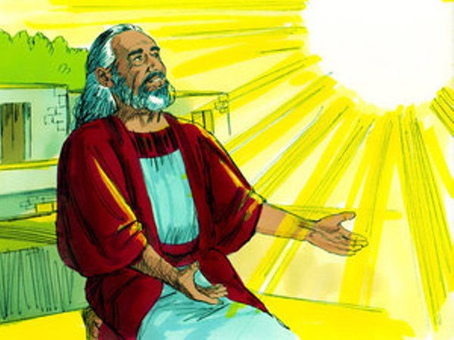
So God said to Noah, “This is the sign of the covenant I have established between me and all life on the earth.”

Slide 17
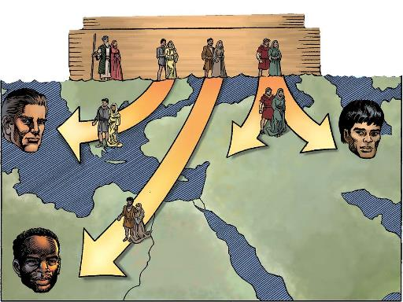
The sons of Noah who came out of the ark were Shem, Ham and Japheth. (Ham was the father of Canaan.) These were the three sons of Noah, and from them came the people who were scattered over the whole earth.

Slide 18
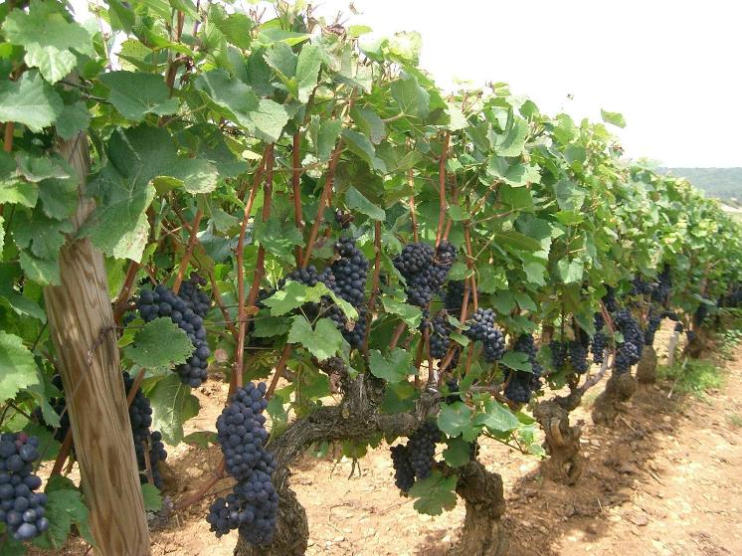
Noah, a man of the soil, proceeded to plant a vineyard.

Slide 19
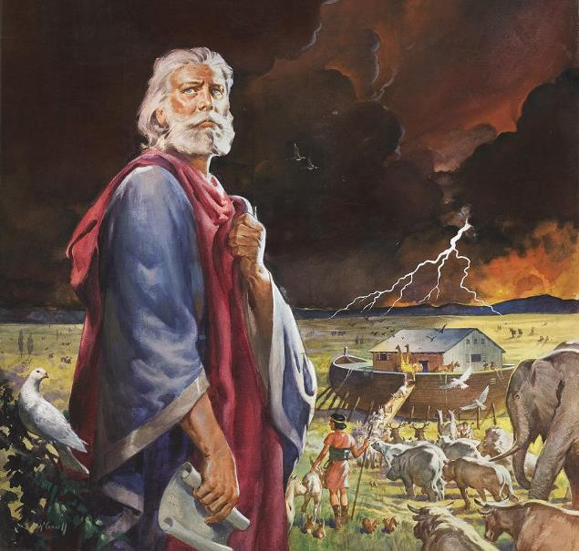
After the flood Noah lived 350 years. Noah lived a total of 950 years, and then he died.

