Slide 1
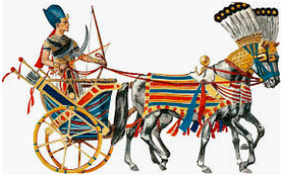
Dig Site #20
Genesis 46:28-32, 50:14-26
"Promises Fulfilled"

Slide 2
The Truth
DIG SITE #20
God works out every situation to His glory!

Slide 3
MEMORY VERSE
DIG SITE #20
Genesis 50:24b
But God will surely come to your aid and take you up out of this land
to the land he promised
on oath to Abraham, Isaac and Jacob.
Genesis 50:24b

Slide 4
Now Jacob sent Judah ahead of him to Joseph to get directions to Goshen.
When they arrived in the region of Goshen, Joseph had his chariot made ready and went to Goshen to meet his father Israel.

Slide 5
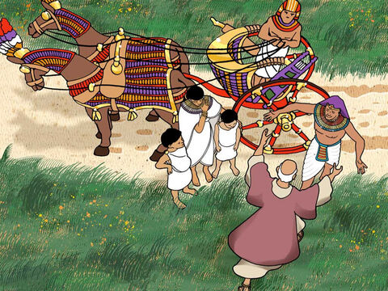
Israel said to Joseph,
As soon as Joseph appeared before him,
he threw his arms around his father and wept for a long time.
Now I am ready to die,
since I have seen for myself that you are still alive.

Slide 6
Then Joseph said to his brothers and to his father’s household,
I will go up and speak to Pharaoh and will say to him,
‘My brothers and my father’s household, who were living in the land of Canaan, have come to me.

Slide 7
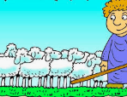
The men are shepherds; they tend livestock, and they have brought along their flocks and herds and everything they own.’

Slide 8
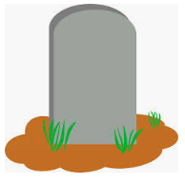
After burying his father, Joseph returned to Egypt, together with his brothers and all the others who had gone with him to bury his father.
Jacob,
(AKA Israel)
Son of Isaac,
Son of Abraham
Chosen of the Lord
Some time later...
(Chapter 50)

Slide 9
When Joseph’s brothers saw that their father was dead, they said,
Jacob,
(AKA Israel)
Son of Isaac,
Son of Abraham
Chosen of the Lord
What if Joseph holds a grudge against us and pays us back for all the wrongs we did to him?

Slide 10
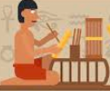
So they sent word to Joseph, saying,
Your father left these instructions before he died:

Slide 11
‘This is what you are to say to Joseph: I ask you to forgive your brothers the sins and the wrongs they committed in treating you so badly.’
Now please forgive the sins of the servants of the God of your father.”

Slide 12

When their message came to him,
Joseph wept. His brothers then came and threw themselves down
before him.
We are your slaves.
We are your slaves,
they
said.

Slide 13
But Joseph said to them,
Don’t be afraid.
Am I in the place
of God?

Slide 14
You intended to harm me, but God intended it for good to accomplish what is now being done, the saving of many lives.

Slide 15
And he reassured them and spoke kindly to them.
So then, don’t be afraid.
I will provide for you and your children.

Slide 16
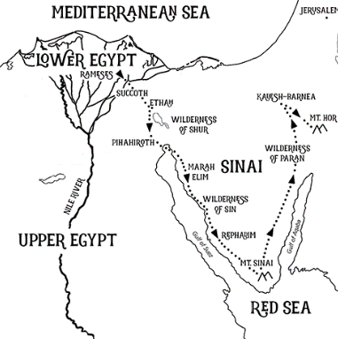
Joseph stayed in Egypt, along with all his father’s family. He lived 110 years,

Slide 17


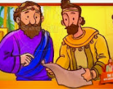


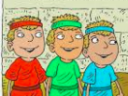
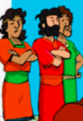
and saw the 3rd generation of Ephraim’s children.
Also the children of Makir son of Manasseh were placed at birth on Joseph’s knees.
Ephraim
Manasseh
Makir

Slide 18
Then Joseph said to his brothers,
I am about to die. But God will surely come to your aid and take you up out of this land to the land he promised on oath to Abraham, Isaac and Jacob.

Slide 19

And Joseph made the Israelites swear an oath and said,
God will surely come to your aid, and then you must carry my bones up from this place.

Slide 20
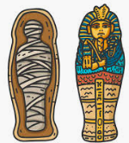
So Joseph died at the age of 110.
And after they embalmed him, he was placed in a coffin in Egypt.

