Slide 1
Dig Site 2
Genesis 2:15-25; 3:1-24
"The Sneaky Serpent"

Slide 2
Dig Site 2
The Truth
God wants a relationship with us!

Slide 3
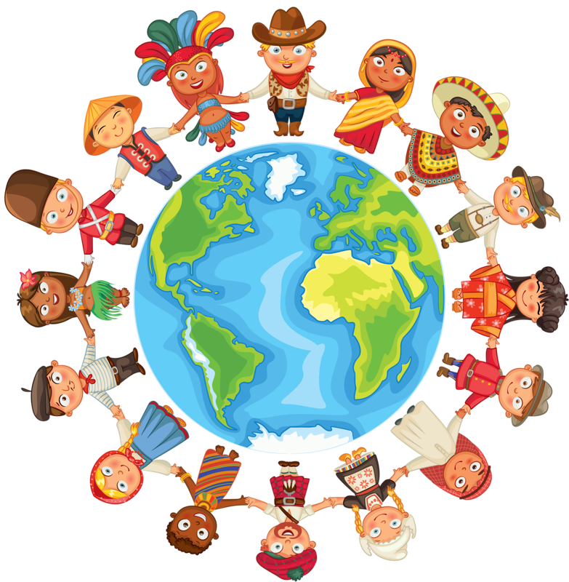
Memory Verse #2
So God created mankind in his own image, in the image of God he created them; male and female he created them.
Genesis 1:27

Slide 4

The Lord God took the man and put him in the Garden of Eden to work it and take care of it.

Slide 5
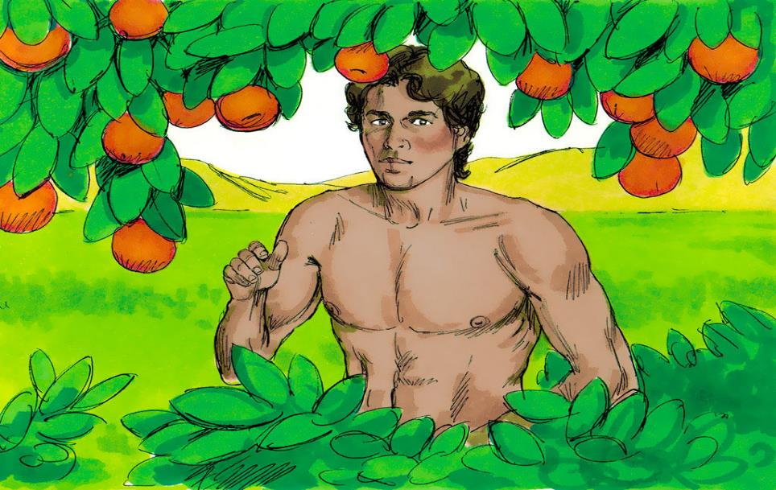
And the Lord God commanded the man, “You are free to eat from any tree in the garden;
but you must not eat from the tree of the knowledge of good and evil, for when you eat from it you will certainly die.”

Slide 6
The Lord God said,
“It is not good for the man to be alone. I will make a helper suitable for him.”

Slide 7
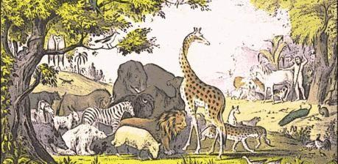
Now the Lord God had formed out of the ground all the wild animals and all the birds in the sky. He brought them to the man to see what he would name them; and whatever the man called each living creature, that was its name.

Slide 8
So the man gave names to all the livestock, the birds in the sky and all the wild animals.

Slide 9

But for Adam no suitable helper was found.

Slide 10
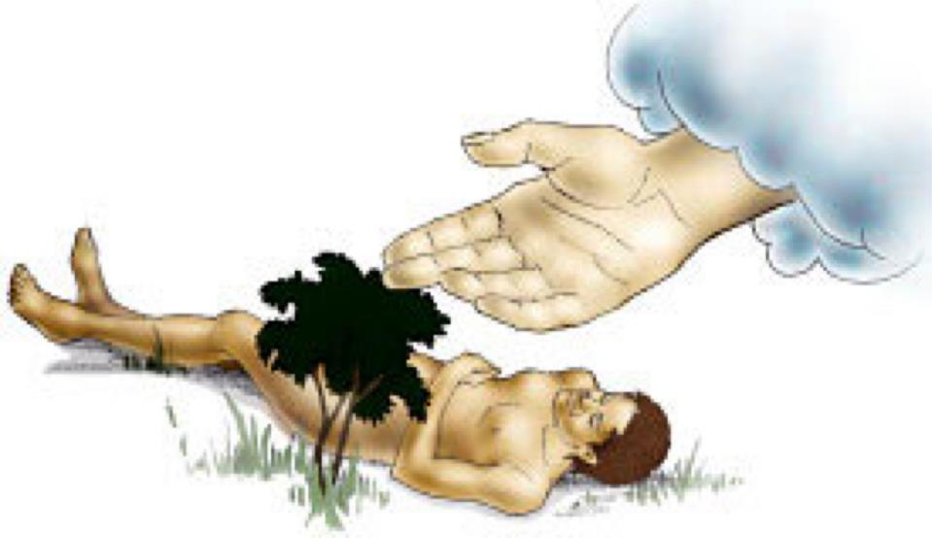
So the Lord God caused the man to fall into a deep sleep; and while he was sleeping, he took one of the man’s ribs and then closed up the place with flesh.

Slide 11
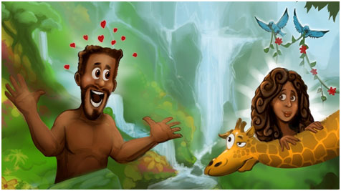
Then the Lord God made a woman from the rib he had taken out of the man, and he brought her to the man.

Slide 12
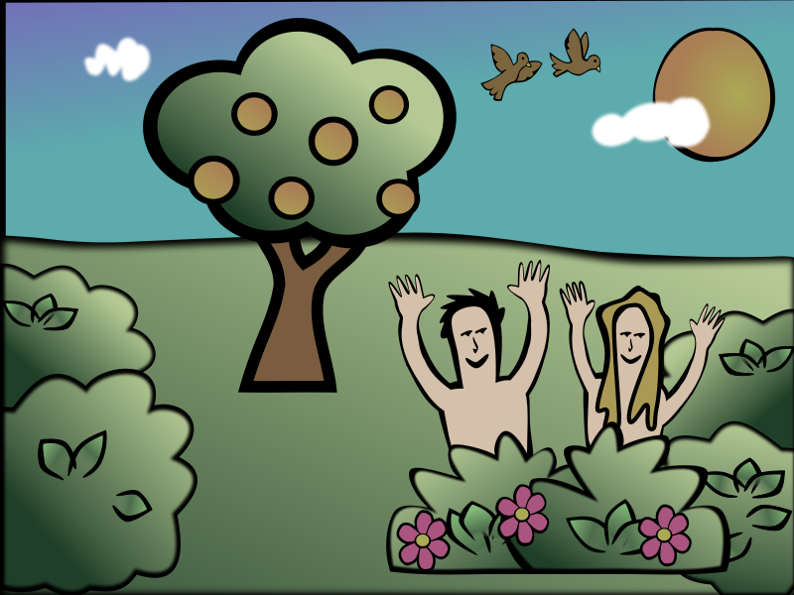
The man said, “This is now bone of my bones and flesh of my flesh; she shall be called ‘woman,’ for she was taken out of man.”

Slide 13
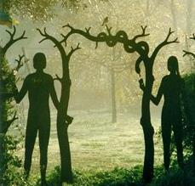
That is why a man leaves his father and mother and is united to his wife, and they become one flesh.
Adam and his wife were both naked, and they felt no shame.

Slide 14
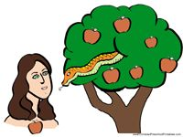
Now the serpent was more crafty than any of the wild animals the Lord God had made.
He said to the woman,
Did God really say, ‘You must not eat from any tree in the garden’?”

Slide 15
The woman said to the serpent,
“We may eat fruit from the trees in the garden,
but God did say,
‘You must not eat
fruit from the tree
that is in the
middle of the
garden, and you must not touch it, or you will die.’”

Slide 16
the serpent said
to the woman.
You will not certainly die,
For God knows that when you eat from it your eyes will be opened, and you will be like God, knowing good and evil.

Slide 17
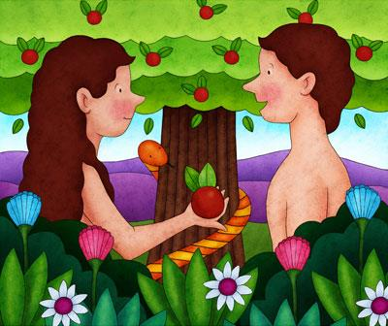
When the woman saw that the fruit of the tree was good for food and pleasing to the eye, and also desirable for gaining wisdom, she took some and ate it.
She also gave some to her husband, who was with her, and he ate it.

Slide 18
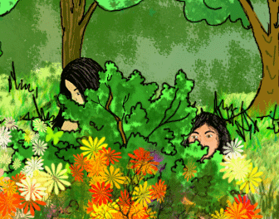
Then the eyes of both of them were opened, and they realized they were naked; so they sewed fig leaves together and made coverings for themselves.

Slide 19
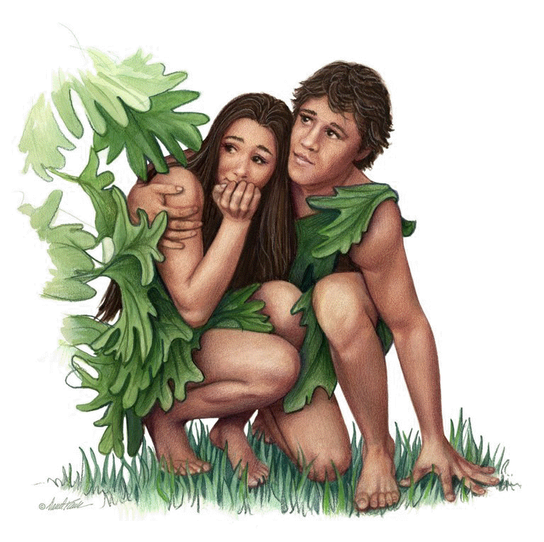
Then the man and his wife heard the sound of the Lord God as he was walking in the garden in the cool of the day, and they hid from the Lord God among the trees of the garden.

Slide 20
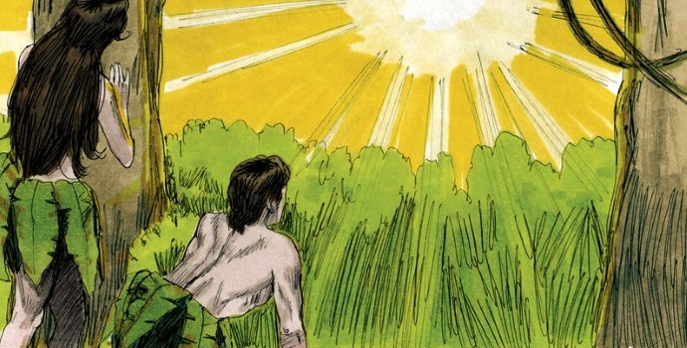
But the Lord God called to the man, “Where are you?”
He answered, “I heard you in the garden, and I was afraid because I was naked; so I hid.”

Slide 21
Who told you that you were naked? Have you eaten from the tree that I commanded you not to eat from?
And he said,
The man said,
The woman you put here with me—she gave me some fruit from the tree, and I ate it.

Slide 22
Then the LORD God said to the woman,
What is this you have done?
The woman said,
The serpent deceived me, and I ate.

Slide 23
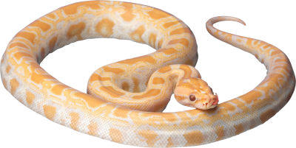
So the Lord God said to the serpent, “Because you have done this, cursed are you above all livestock and all wild animals! You will crawl on your belly and you will eat dust all the days of your life.

Slide 24
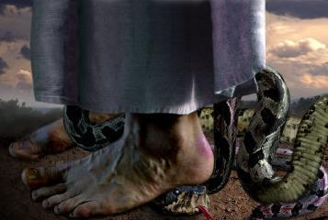
And I will put enmity
between you and the woman,
and between your offspring and hers; he will crush your head,
and you will strike his heel.

Slide 25
To the woman he said, “I will make your pains in childbearing very severe; with painful labor you will give birth to children. Your desire will be for your husband, and he will rule over you.”

Slide 26
To Adam he said, “Because you listened to your wife and ate fruit from the tree about which I commanded you, ‘You must not eat from it,’
“Cursed is the ground because of you; through painful toil you will eat food from it all the days of your life.

Slide 27


It will produce thorns and thistles for you,
and you will eat the plants of the field. By the sweat of your brow you will eat your food until you return to the ground, since from it you were taken; for dust you are and to dust you will return.”

Slide 28
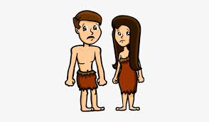
Adam named his wife Eve, because she would become the mother of all the living. The Lord God made garments of skin for Adam and his wife and clothed them.

Slide 29
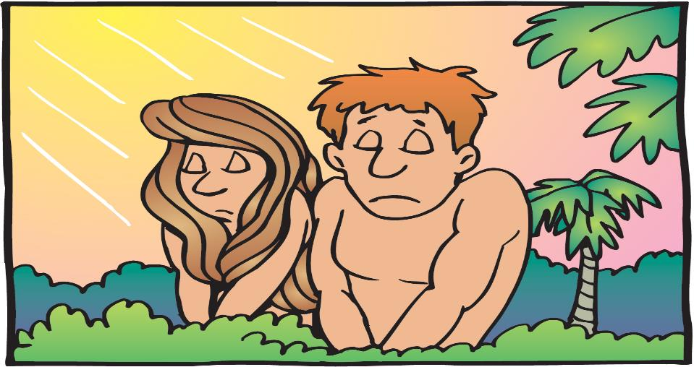
And the Lord God said, “The man has now become like one of us, knowing good and evil. He must not be allowed to reach out his hand and take also from the tree of life and eat, and live forever.”

Slide 30
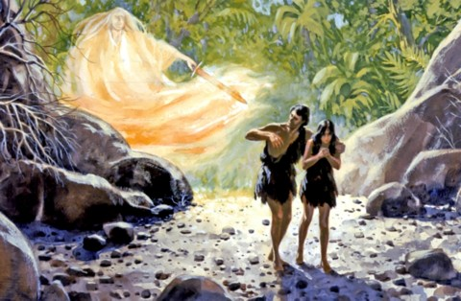
So the Lord God banished him from the Garden of Eden to work the ground from which he had been taken.
After he drove the man out, he placed on the east side of the Garden of Eden cherubim and a flaming sword flashing back and forth to guard the way to the tree of life.

