Slide 1
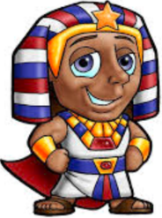
Genesis 41:1-57
Promoted!

Slide 2
The Truth
God honors those who are faithful to Him!

Slide 3
Memory Verse
Genesis 41:16
"'I cannot do it,' Joseph replied to Pharaoh, 'but God will give Pharaoh the answer he desires.'"

Slide 4
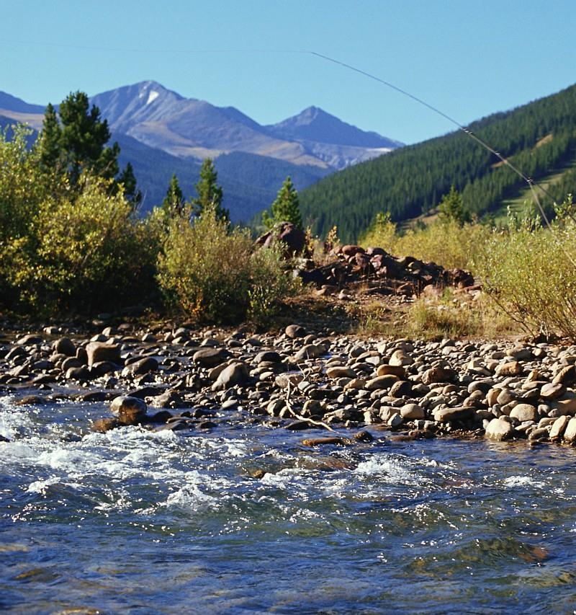
When 2 full years had passed, Pharaoh had a dream: He was standing by the Nile,

Slide 5
when out of the river there came up 7 cows, sleek and fat, and they grazed among the reeds.

Slide 6

After them, 7 other cows, ugly and gaunt, came up out of the Nile and stood beside those on the riverbank.

Slide 7
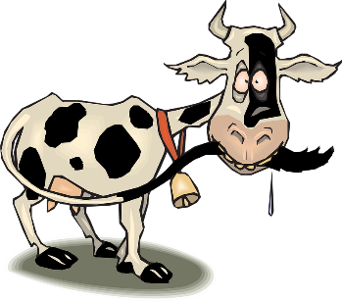
And the cows that were ugly and
gaunt ate up the 7 sleek, fat cows.
Then Pharaoh woke up.

Slide 8
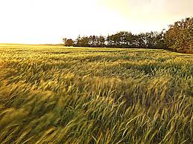
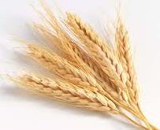
He fell asleep again and had a second dream: 7 heads of grain, healthy and good, were growing on a single stalk.

Slide 9
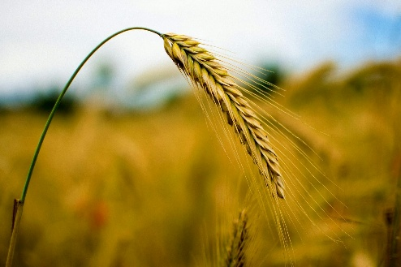
After them, 7 other heads of grain sprouted—thin and scorched by the east wind.

Slide 10

The thin heads of grain swallowed up the 7 healthy, full heads. Then Pharaoh woke up; it had been a dream.

Slide 11
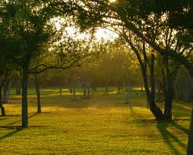

In the morning his mind was troubled, so he sent for all the magicians and wise men of Egypt. Pharaoh told them his dreams, but no one could interpret them for him.

Slide 12
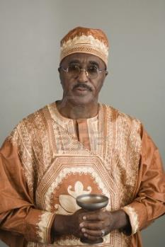
Then the chief cupbearer said to Pharaoh,
Today I am reminded of my shortcomings.

Slide 13
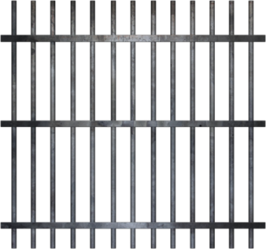

Pharaoh was once angry with his servants, and he imprisoned me and the chief baker in the house of the captain of the guard.

Slide 14


Each of us had a dream the same night, and each dream had a meaning of its own.

Slide 15
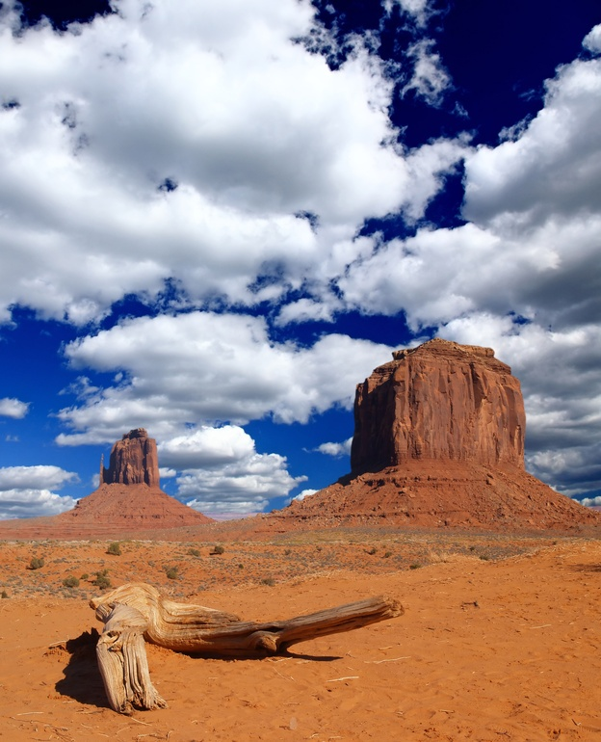
Now a young Hebrew was there with us, a servant of the captain of the guard.
We told him our dreams, and he interpreted them for us, giving each man the interpretation of his dream.

Slide 16


And things turned out exactly as he interpreted them to us: I was restored to my position, and the other man was impaled.

Slide 17
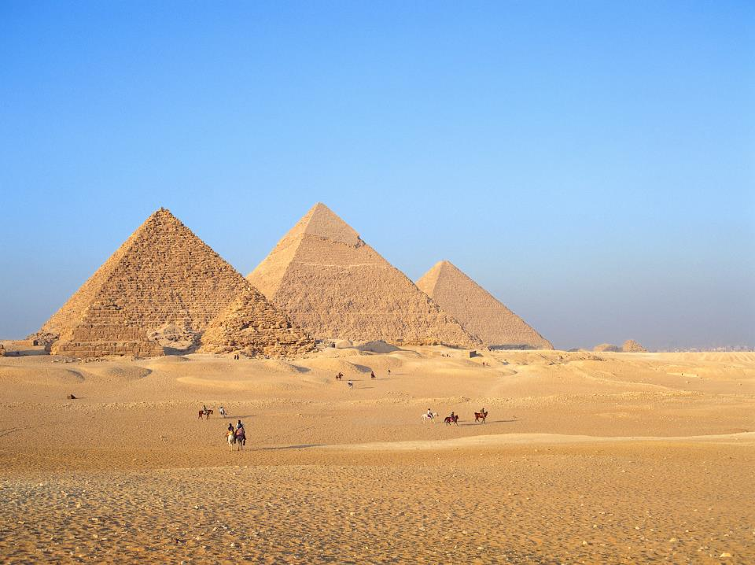
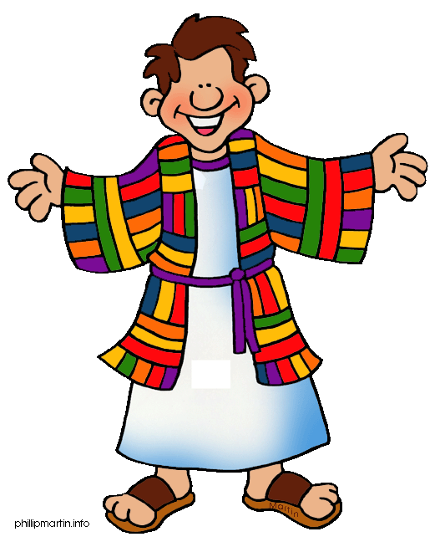
So Pharaoh sent for Joseph, and he was quickly brought from the dungeon. When he had shaved and changed his clothes, he came before Pharaoh.

Slide 18
Pharaoh said to Joseph,
I had a dream, and no one can interpret it. But I have heard it said of you that when you hear a dream you can interpret it.

Slide 19
Joseph replied to Pharaoh,
I cannot do it,
but God will give Pharaoh the answer he desires.

Slide 20
Then Pharaoh said to Joseph,
In my dream I was standing on the bank of the Nile, when out of the river there came up 7 cows, fat and sleek, and they grazed among the reeds.

Slide 21

After them, 7 other cows came up—scrawny and very ugly and lean. I had never seen such ugly cows in all the land of Egypt. The lean, ugly cows ate up the 7 fat cows that came up first.
But even after they ate them, no one could tell that they had done so; they looked just as ugly as before. Then I woke up.

Slide 22
In my dream I saw 7 heads of grain, full and good, growing on a single stalk.

Slide 23
After them, 7 other heads sprouted—withered and thin and scorched by the east wind.

Slide 24

The thin heads of grain swallowed up the 7 good heads. I told this to the magicians, but none of them could explain it to me.

Slide 25
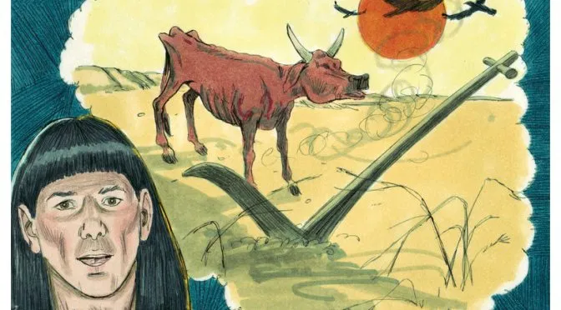
Then Joseph said to Pharaoh,
The dreams of Pharaoh are one and the same. God has revealed to Pharaoh what he is about to do.

Slide 26
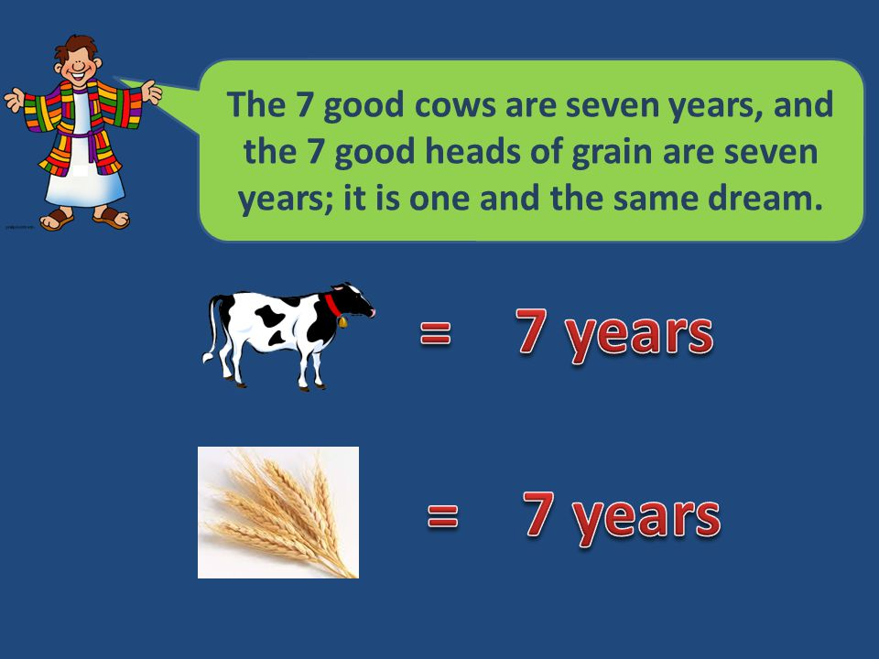

Slide 27
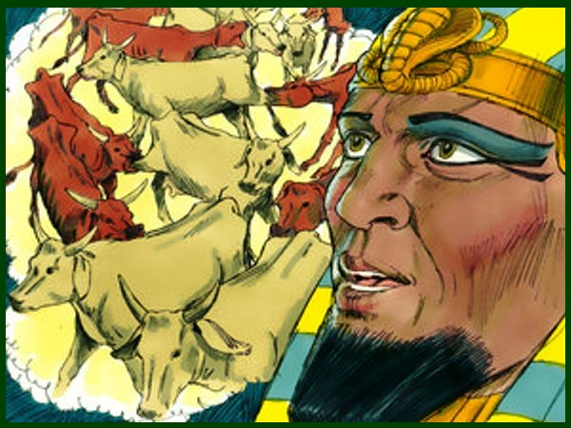
The 7 lean, ugly cows that came up afterward are 7 years,

Slide 28
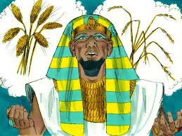
and so are the 7 worthless heads of grain scorched by the east wind: They are 7 years of famine.

Slide 29
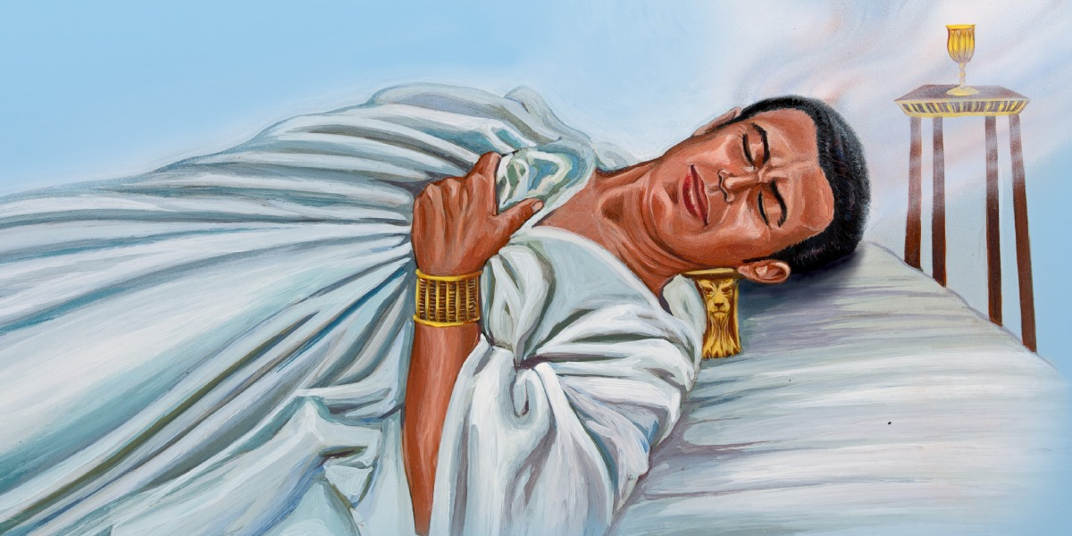
It is just as I said to Pharaoh: God has shown Pharaoh what he is about to do.

Slide 30
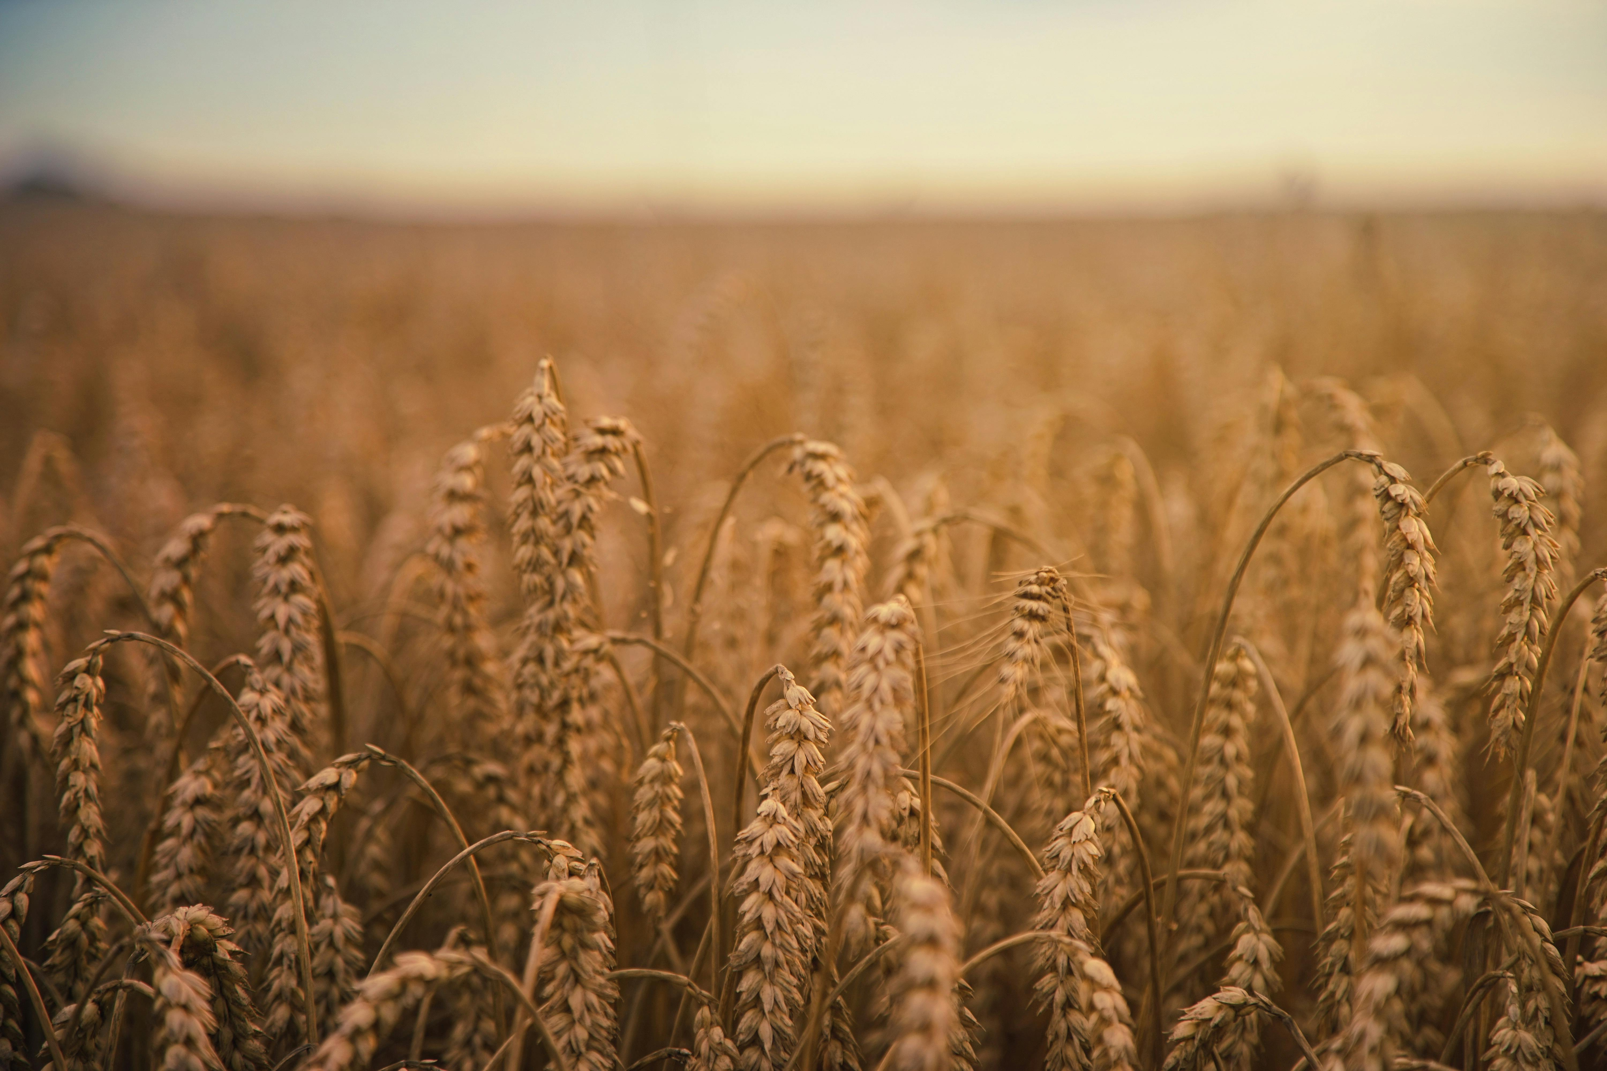
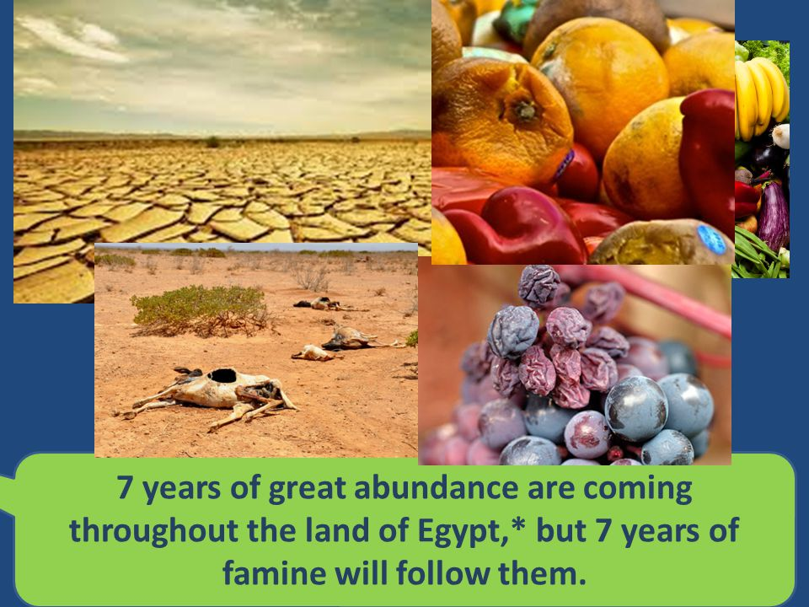
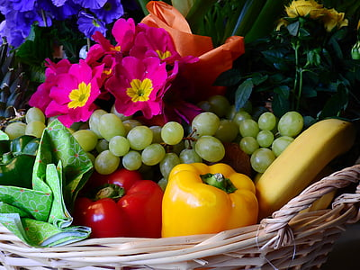
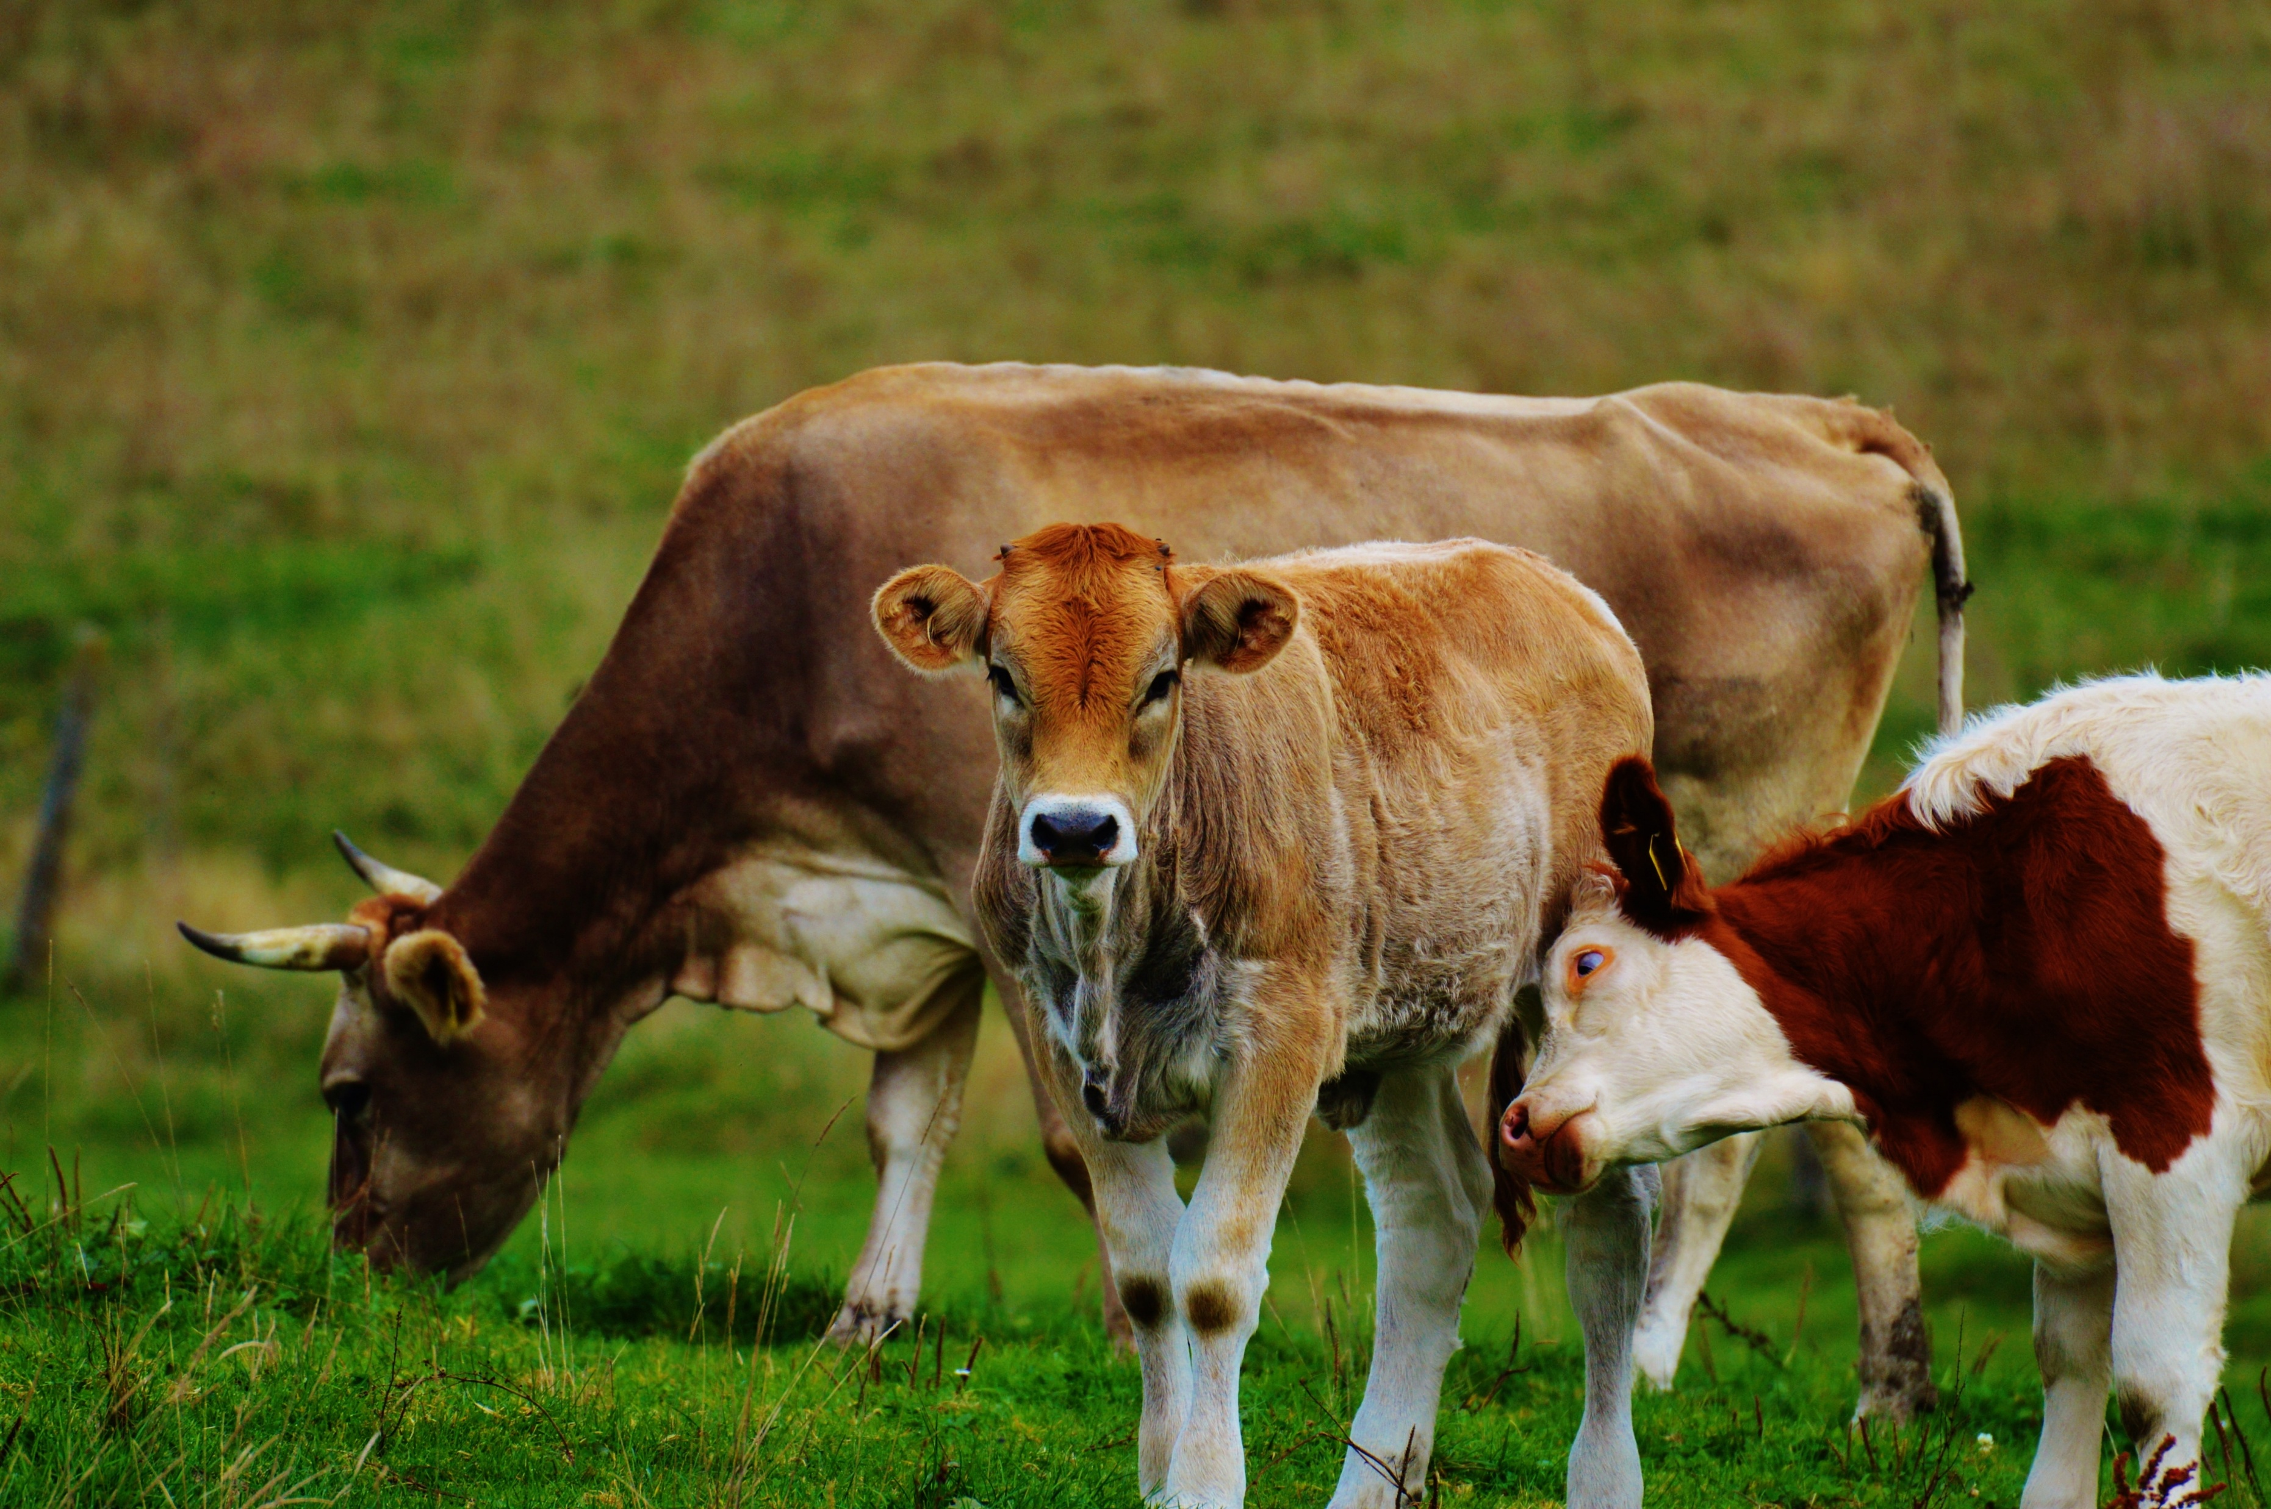
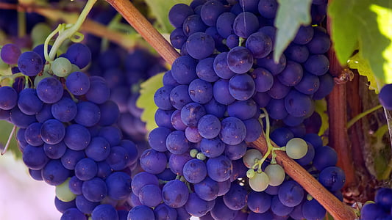

Slide 31
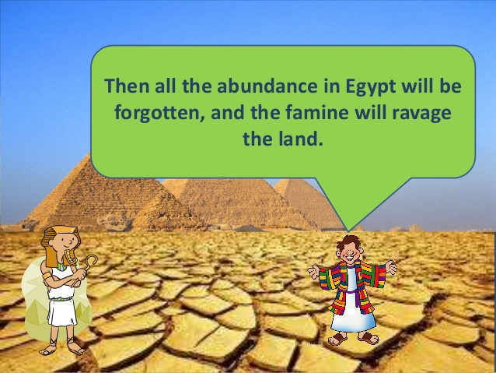

Slide 32
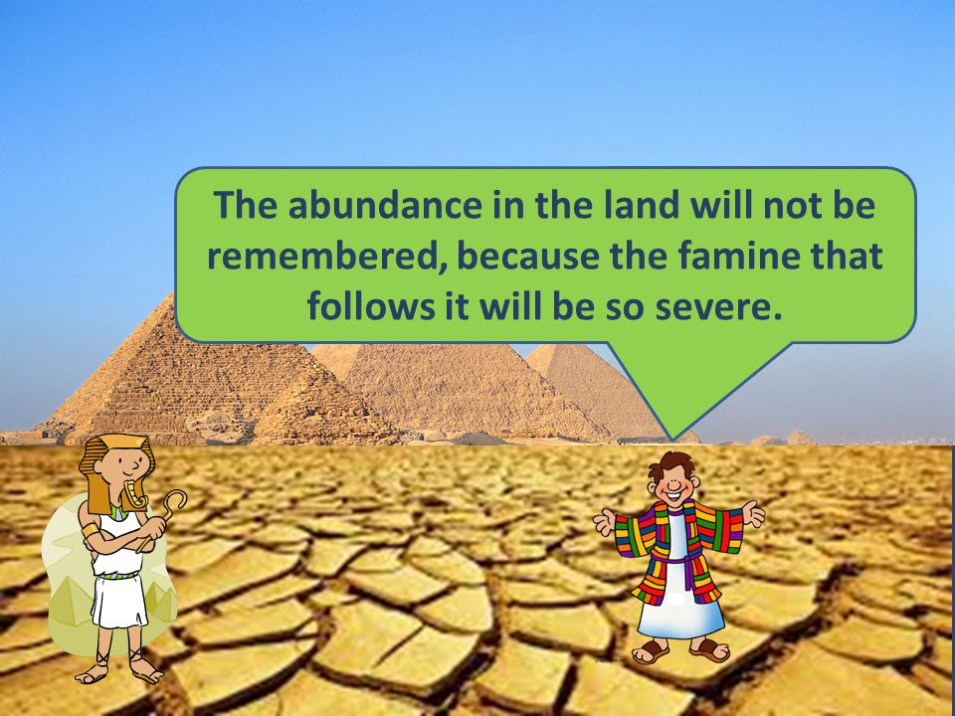

Slide 33
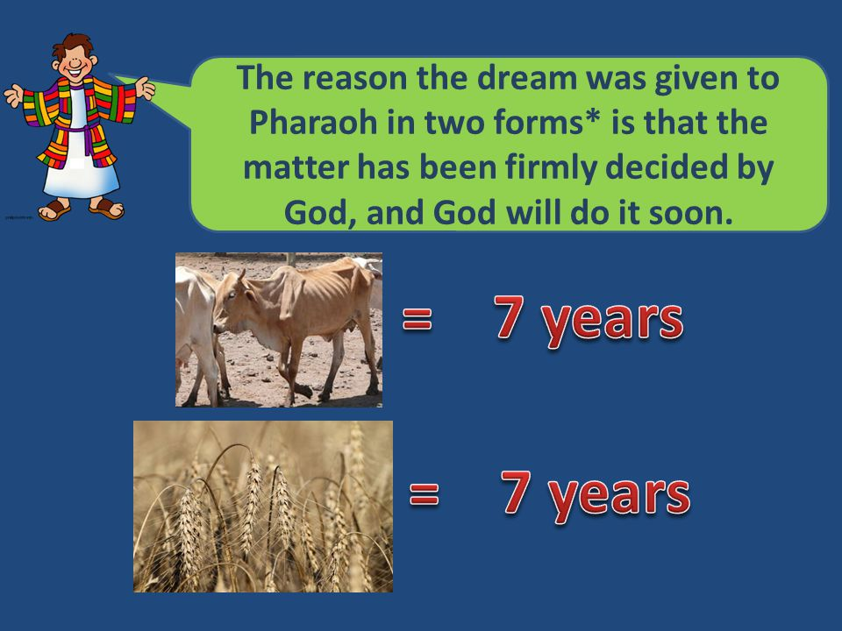

Slide 34
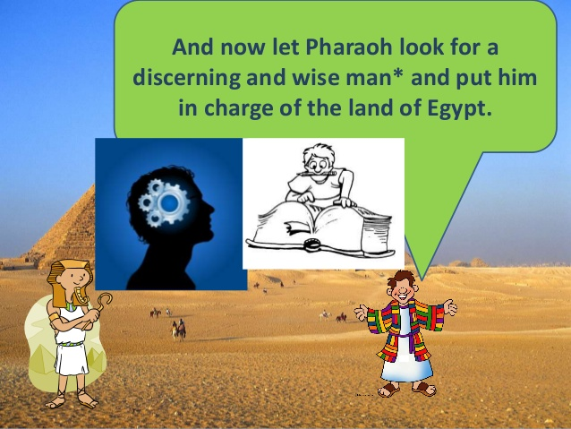

Slide 35
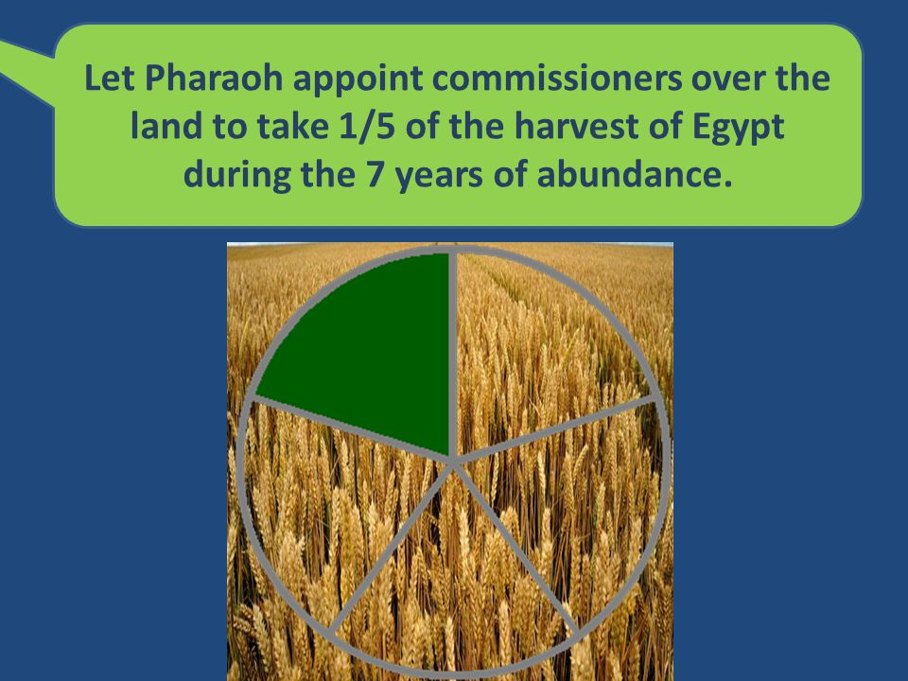

Slide 36
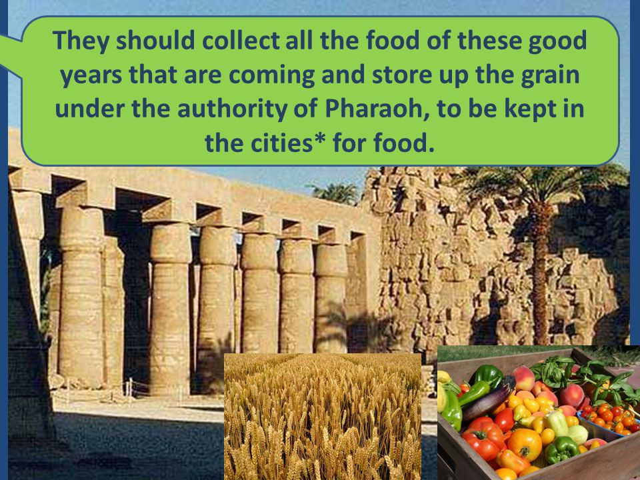

Slide 37
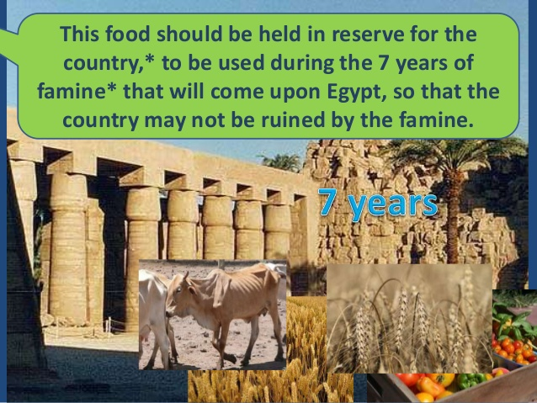

Slide 38
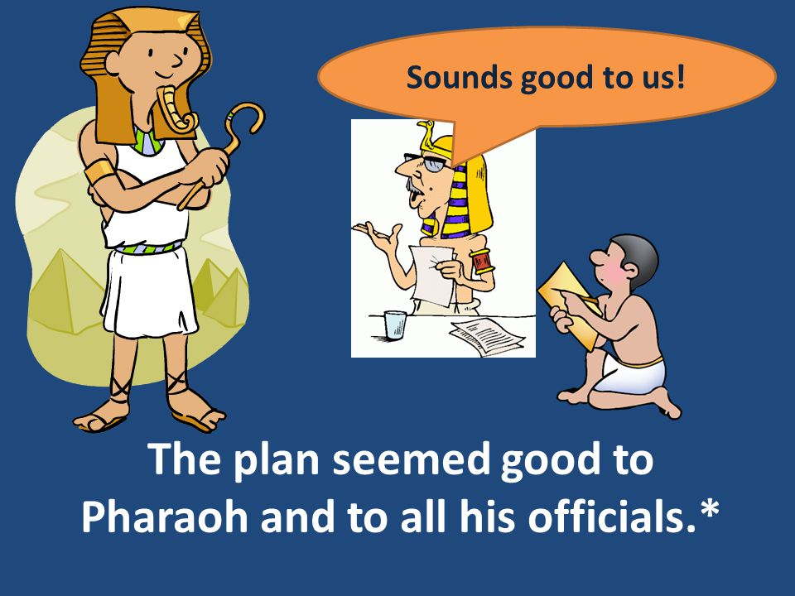

Slide 39
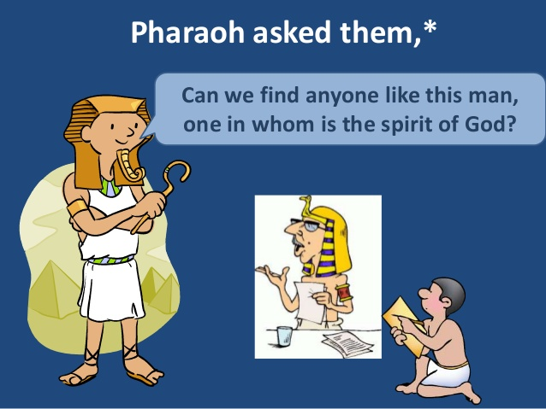

Slide 40
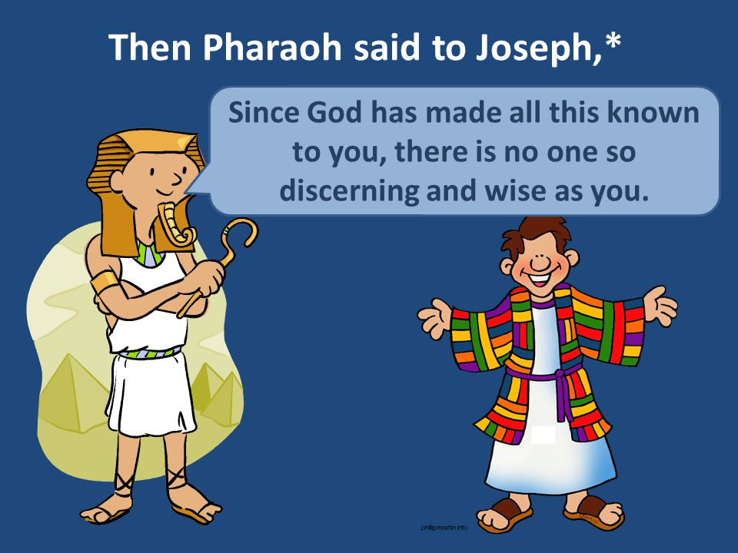

Slide 41
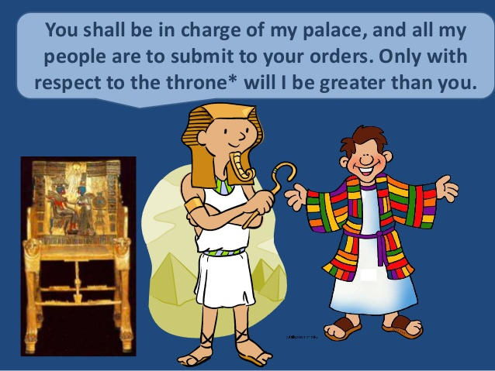

Slide 42

Joseph in Charge of Egypt

Slide 43
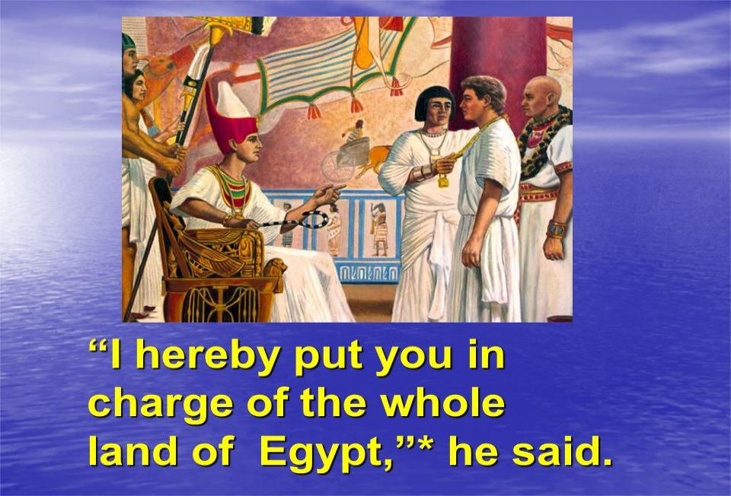
So Pharaoh said to Joseph,

Slide 44
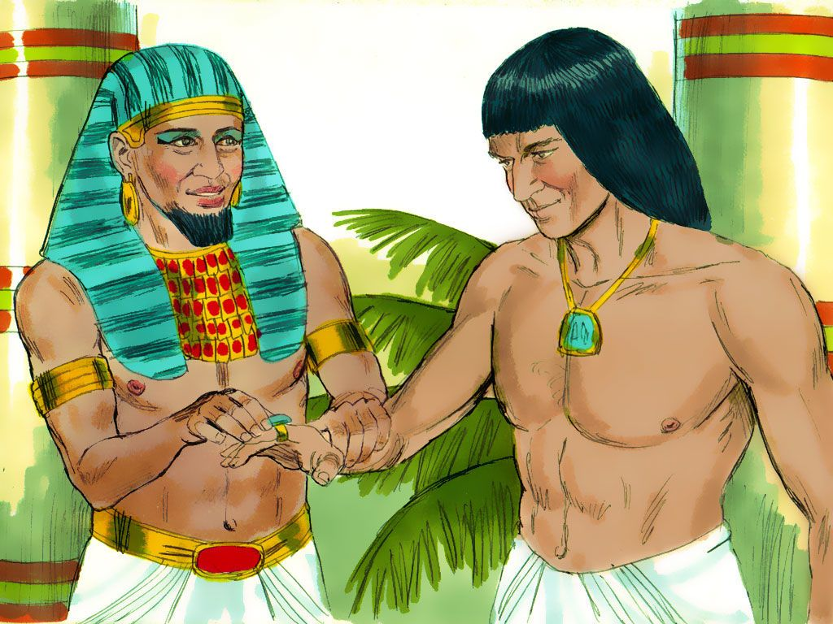
Then Pharaoh took his signet ring from his finger and put it on Joseph’s finger.

Slide 45
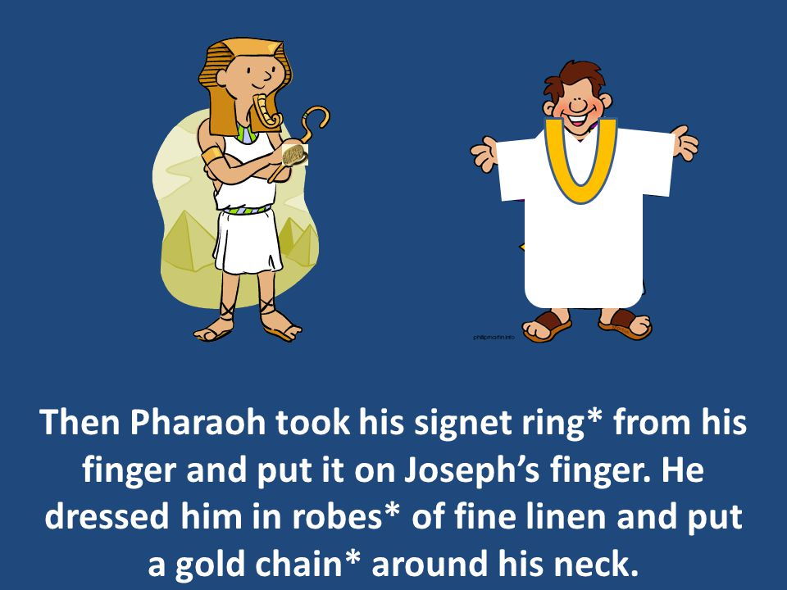
He dressed him in robes of fine linen and put a gold chain around his neck.

Slide 46
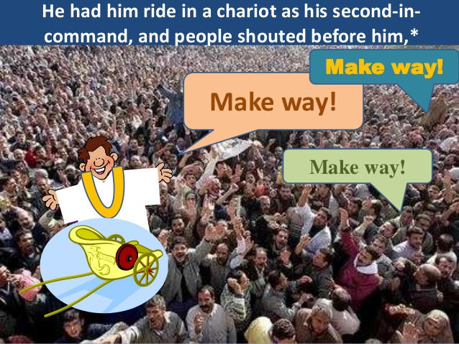

Slide 47
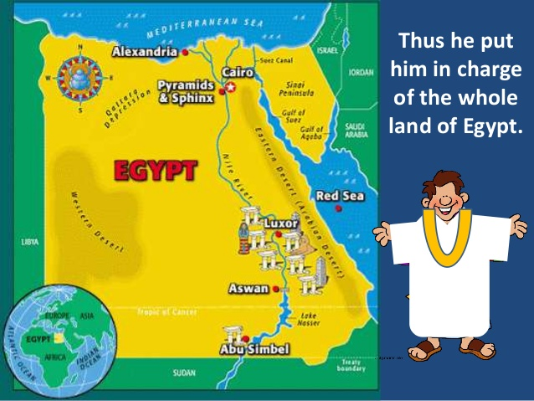

Slide 48
Then Pharaoh said to Joseph, “I am Pharaoh, but without your word no one will lift hand or foot in all Egypt.”

Slide 49
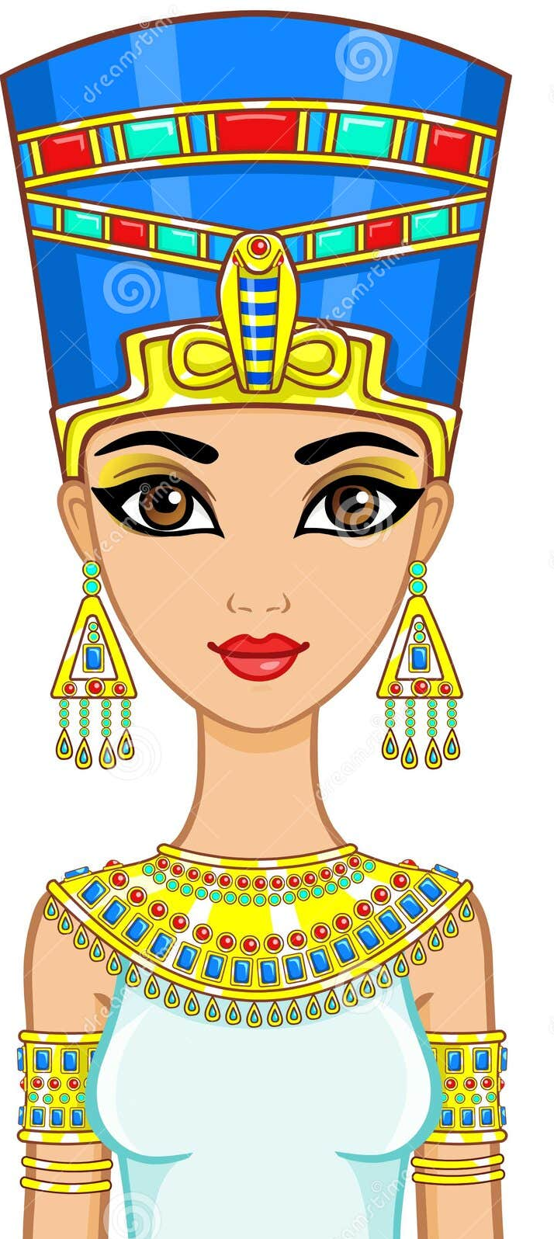
Pharaoh gave Joseph the name Zaphenath-Paneah and gave him Asenath* daughter of Potiphera, priest of On, to be his wife.

Slide 50
And Joseph went throughout the land of Egypt. Joseph was 30 years old when he entered the service of Pharaoh king of Egypt.
And Joseph went out from Pharaoh’s presence and traveled throughout Egypt.

Slide 51
During the 7 years of abundance the land produced plentifully.

Slide 52
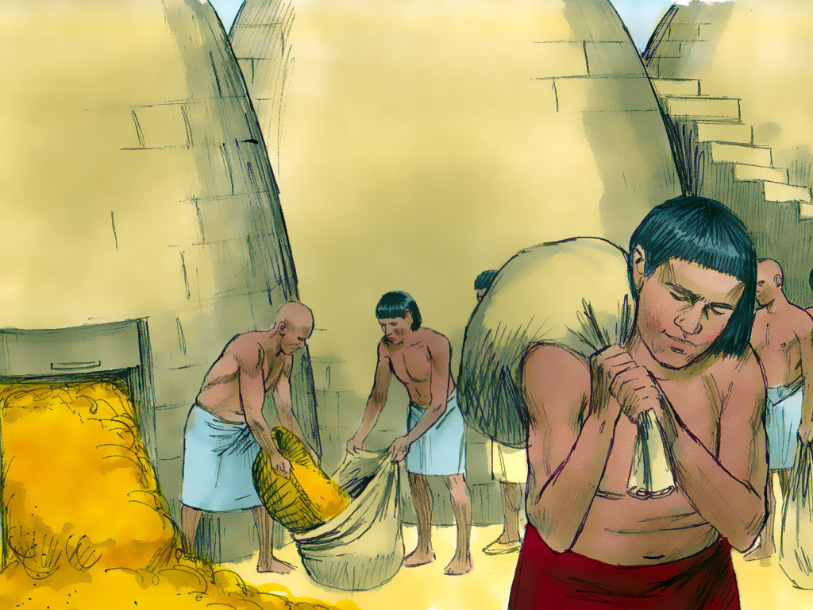
Joseph collected all the food produced in those seven years of abundance in Egypt and stored it in the cities. In each city he put the food grown in the fields surrounding it.

Slide 53
Joseph stored up huge quantities of grain, like sand of the sea; it was so much that he stopped keeping records because it was beyond measure.

Slide 54
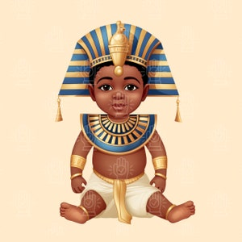
Manasseh
Before the years of famine came, two sons were born to Joseph by Asenath daughter of Potiphera, priest of On. Joseph named his firstborn Manasseh and said, “It is because God has made me forget all my trouble and all my father’s household.

Slide 55
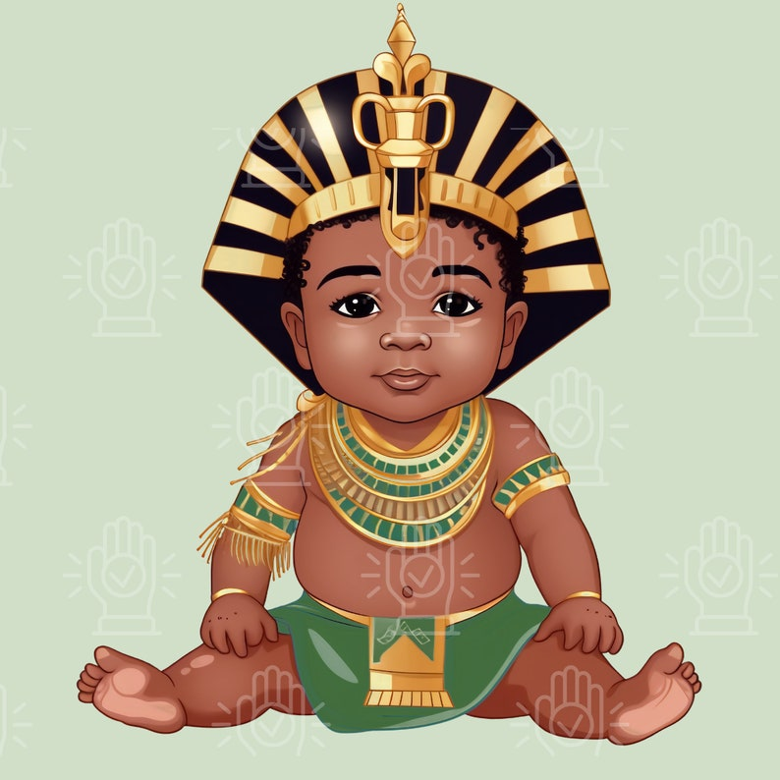
Manasseh
Ephraim
The second son he named Ephraim and said, “It is because God has made me fruitful in the land of my suffering.

Slide 56
The seven years of abundance in Egypt came to an end, and seven years of famine began, just as Joseph had said.

Slide 57
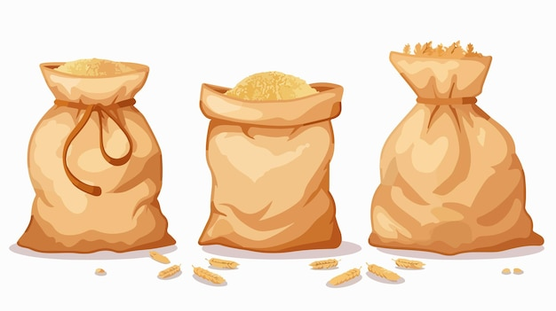
Go to Joseph!
There was famine in all the other lands but in the whole land of Egypt there was food. When all of Egypt began to feel the famine, the people cried out to Pharaoh for food. Then Pharaoh told all the Egyptians, “Go to Joseph and do what he tells you.”

Slide 58
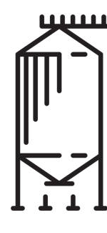
When the famine spread over the whole country, Joseph opened the storehouses and sold grain to the Egyptians, for the famine was severe throughout all of Egypt.

Slide 59
And all the world came to Egypt to buy grain from Joseph, because the famine was severe everywhere.

