Slide 1
Dig Site 11
Genesis 25:5-11, 19-34
It's Twins!

Slide 2
The Truth
God continued to be faithful to Abraham's descendants!

Slide 3
Memory Verse
Even small children are known by their actions,
so is their conduct really
pure and upright?
Proverbs 20:11

Slide 4
Abraham left everything he owned to Isaac. But while he was still living, he gave gifts to the sons of his concubines and sent them away from his son Isaac to the land of the east.

Slide 5
Abraham lived 175 years.
Then Abraham breathed his last and
died at a good old age,
an old man and full of years;
and he was gathered to his people.

Slide 6
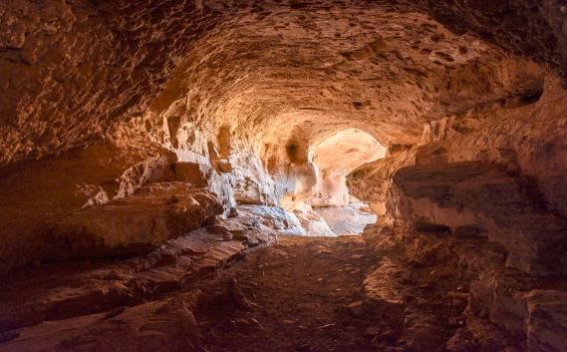
His sons Isaac and Ishmael buried him in the cave of Machpelah near Mamre,
in the field of Ephron son of Zohar the Hittite, the field Abraham had bought from the Hittites.
There Abraham was buried
with his wife Sarah.

Slide 7
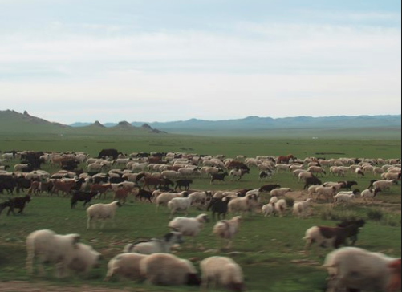
After Abraham's death,
God blessed his son Isaac,
who then lived near Beer Lahai Roi.

Slide 8
This is the account of the family line of Abraham's son, Isaac.

Slide 9
Abraham became the father of Isaac,
and Isaac was 40 years old when he married Rebekah…
40

Slide 10
…daughter of Bethuel the Aramean from Paddan Aram and sister of Laban the Aramean.

Slide 11
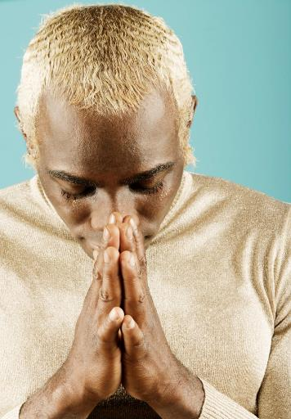
Isaac prayed to the LORD on behalf of his wife, because she was childless.
The LORD answered his prayer, and his wife Rebekah became pregnant.

Slide 12
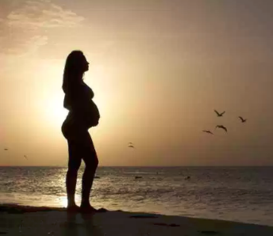
The babies jostled each other within her, and she said,
“Why is this happening
to me?”
So she went to inquire of the LORD.

Slide 13
The LORD said to her,
"Two nations are in your womb,
and two peoples from within you will be separated;
one people will be stronger
than the other, and the older will serve the younger."

Slide 14
When the time came for her to give birth, there were twin boys in her womb.

Slide 15
The first to come out was red,
and his whole body was like a hairy garment;
so they named
him Esau.

Slide 16
After this,
his brother came out, with his hand grasping Esau's heel;
so he was named Jacob.

Slide 17
Isaac was 60 years old when Rebekah gave birth to them.
60

Slide 18
The boys grew up, and Esau became a skillful hunter, a man of the open country,
while Jacob was content to stay at home among the tents.
ESAU
JACOB

Slide 19
Isaac, who had a taste for wild game, loved Esau, but Rebekah loved Jacob.
JACOB
ESAU

Slide 20

Once when Jacob was cooking some stew, Esau came in from the open country, famished.
He said to Jacob,
Quick, let me have
some of that red stew!
I'm famished!
That is why he was also called Edom
Jacob replied,
First sell me
your birthright.

Slide 21
Esau said.
Look, I am about to die,
What good is the birthright to me?
But Jacob said,
Swear to me first.
So he swore an oath to him,
selling his birthright
to Jacob.

Slide 22
Then Jacob gave Esau some bread
and some lentil stew.
He ate and drank, and then got up and left.
So Esau despised his birthright.

