Slide 1
Dig Site 10 Genesis 24:1-4, 10-21, 28-33, 50-54, 61-67 Here Comes the Bride

Slide 2
The Truth
God cares about the details of our lives!

Slide 3
Memory Verse
I will instruct you and teach you in the way you should go; I will counsel you with my loving eye on you.
Psalm 32:8

Slide 4
Abraham was now very old and the LORD had blessed him in every way.

Slide 5
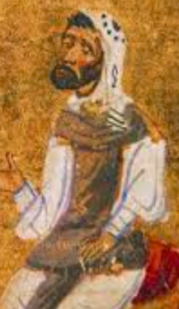

He said to the senior servant in his household, the one in charge of all that he had, "Put your hand under my thigh.

Slide 6
I want you to swear by the LORD, the God of heaven and the God of earth, that you will not get a wife for my son from the daughters of the Canaanites, among whom I am living, but will go to my country and my own relatives and get a wife for my son Isaac."
Canaanite

Slide 7
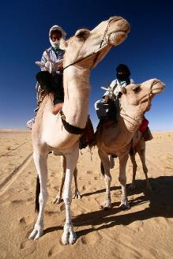

Then the servant left taking with him 10 of his master's camels loaded with all kinds of good things from his master. He set out for Aram Naharaim and made his way to the town of Nahor.

Slide 8
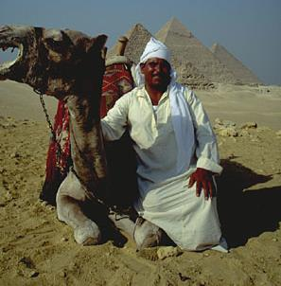
He had the camels kneel down near the well outside the town; it was toward evening, the time the women go out to draw water.

Slide 9
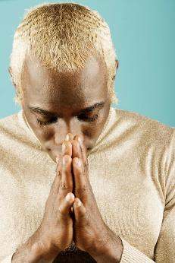
Then he prayed, "LORD, God of my master Abraham, make me successful today, and show kindness to my master Abraham.

Slide 10
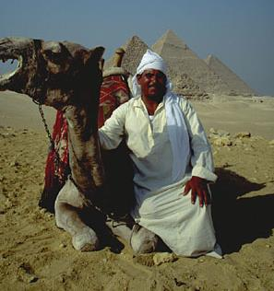
See, I am standing beside this spring, and the daughters of the townspeople are coming out to draw water.

Slide 11

let her be the one you have chosen for your servant Isaac.
May it be that when I say to
a young woman,
and she says,
Please let down your jar that I may have a drink
Drink, and I'll water your camels too

Slide 12
“By this I will know that you have shown kindness to my master."

Slide 13
Before he had finished praying, Rebekah came out with her jar on her shoulder. She was the daughter of Bethuel son of Milcah, who was the wife of Abraham's brother Nahor.

Slide 14
The girl was very beautiful, a virgin; no man had ever slept with her. She went down to the spring, filled her jar and came up again.

Slide 15
The servant hurried to meet her and said, "Please give me a little water from your jar." "Drink, my lord," she said, and quickly lowered the jar to her hands and gave him a drink.

Slide 16
After she had given him a drink, she said, "I'll draw water for your camels too, until they have had enough to drink." So she quickly emptied her jar into the trough, ran back to the well to draw more water, and drew enough for all his camels.

Slide 17
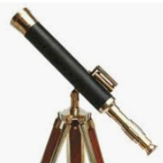
Without saying a word, the man watched her closely to learn whether or not the LORD had made his journey successful.

Slide 18
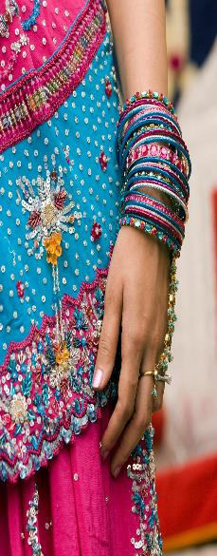
The girl ran and told her mother's household about these things. Now Rebekah had a brother named Laban, and he hurried out to the man at the spring. As soon as he had seen the nose ring, and the bracelets on his sister's arms, and had heard Rebekah tell what the man said to her, he went out to the man and found him standing by the camels near the spring.

Slide 19
"Come, you who are blessed by the LORD," he said. "Why are you standing out here? I have prepared the house and a place for the camels." So the man went to the house, and the camels were unloaded. Straw and fodder were brought for the camels, and water for him and his men to wash their feet.

Slide 20
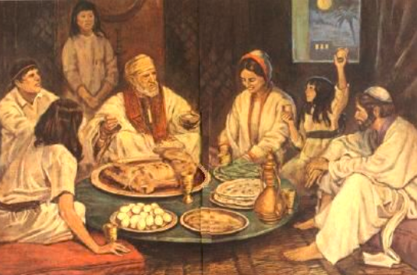
Then food was set before him, but he said, "I will not eat until I have told you what I have to say." "Then tell us," Laban said.

Slide 21
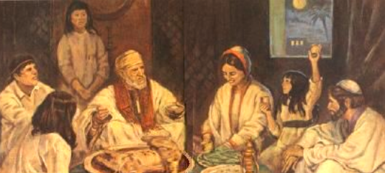
Laban and Bethuel answered, "This is from the LORD; we can say nothing to you one way or the other. Here is Rebekah; take her and go, and let her become the wife of your master's son, as the LORD has directed."

Slide 22
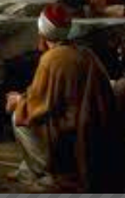
When Abraham's servant heard what they said, he bowed down to the ground before the LORD.

Slide 23
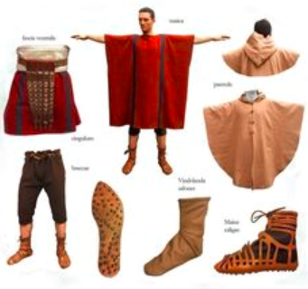
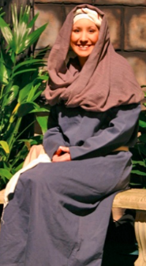
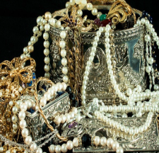
Then the servant brought out gold and silver jewelry and articles of clothing and gave them to Rebekah; he also gave costly gifts to her brother and to her mother.

Slide 24
Then Rebekah and her attendants got ready and mounted their camels and went back with the man. So the servant took Rebekah and left.

Slide 25

Now Isaac had come from Beer Lahai Roi, for he was living in the Negev. He went out to the field one evening to meditate, and as he looked up, he saw camels approaching.

Slide 26
Rebekah also looked up and saw Isaac. She got down from her camel and asked the servant,
Who is that man in the field coming to meet us?
"He is my master,"
the servant answered.
So she took her veil and covered herself.

Slide 27
Then the servant told Isaac all he had done. Isaac brought her into the tent of his mother Sarah, and he married Rebekah. So she became his wife, and he loved her; and Isaac was comforted after his mother's death.

